Slide 1
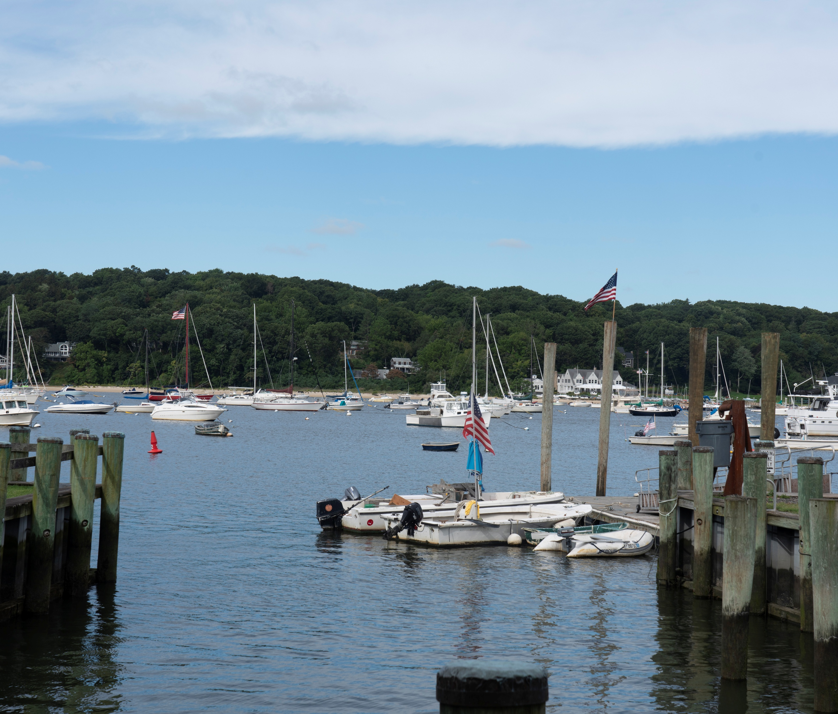

VILLAGE OF NORTHPORT
e of Northport Comprehensive Plan
COMPREHENSIVE PLAN
2026 DRAFT

Slide 2
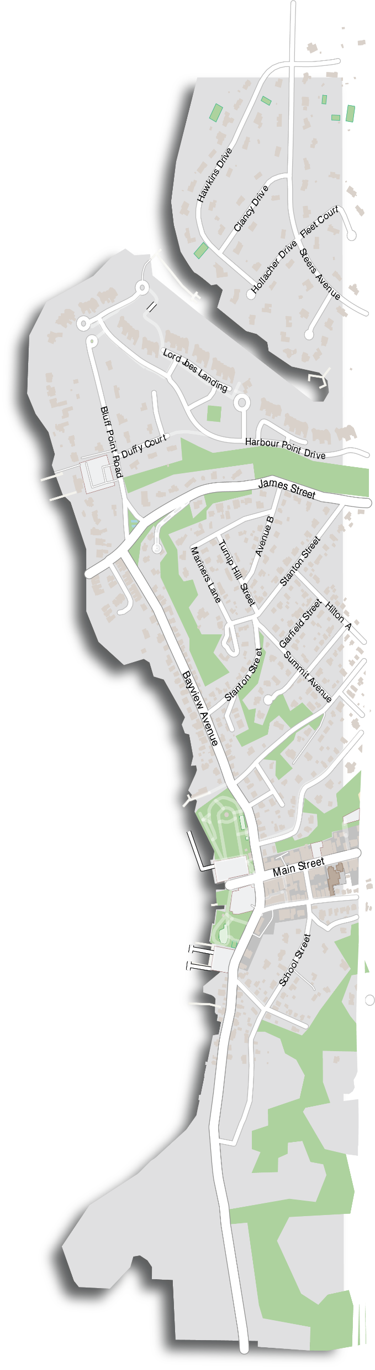




WHAT IS A COMPREHENSIVE PLAN?
A document that guides immediate and long-range growth, protection, and enhancement in a Village.
Assesses the issues and opportunities confronting the Village.
Sets the Vision, Goals, and Objectives for preservation and growth for the next 10-20 years in the Village.
A Comprehensive Plan DOES NOT enact specific policy decisions but rather provides a ROADMAP and SUGGESTIONS for future decision making in the Village
BASIC QUESTIONS
WHY IS IT
IMPORTANT?
Where Are We Now?
All Village land use regulations must be in accordance with an adopted comprehensive plan as required by NYS Village Law
Proactive vs Reactive - builds community consensus & coordination in advance
Can help to attract investment and support future grant funding opportunities
Where Are We Going?
Where Do We Want to Be?
How Do We Get There?

Slide 3
COMPREHENSIVE PLANNING PROCESS
Establish a Comprehensive Plan Advisory Group
Develop Community Survey
Analyze Existing Conditions
Public Open House and Outreach Meeting
Bayview Public Outreach Meeting
Transportation Study and Intersection Analysis
Parking Utilization Study
Identify Goals, Objectives & Recommendations
Drafting of the Plan
Draft Plan presented to the Public
Written comment period on Draft Plan. CPC to prepare Final Plan
Village Board Holds Public Hearing, conducts Environmental Review
Adoption of the Comprehensive Plan
Develop the Vision and Conceptual Future Land Uses
We Are Here

Slide 4
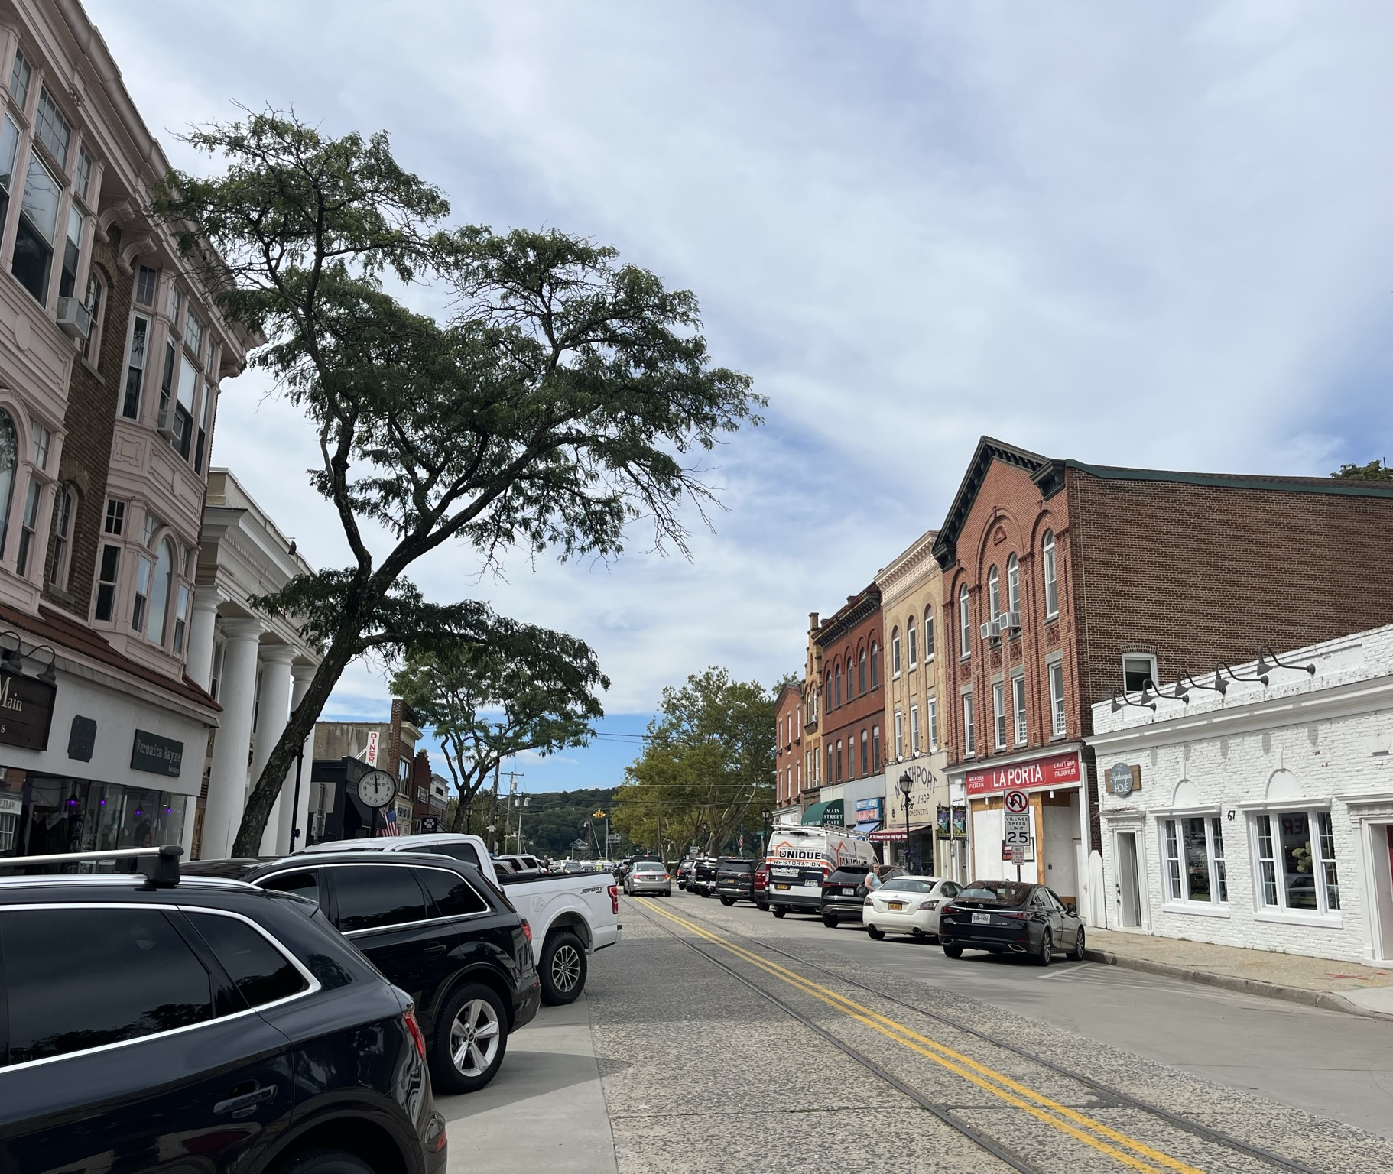
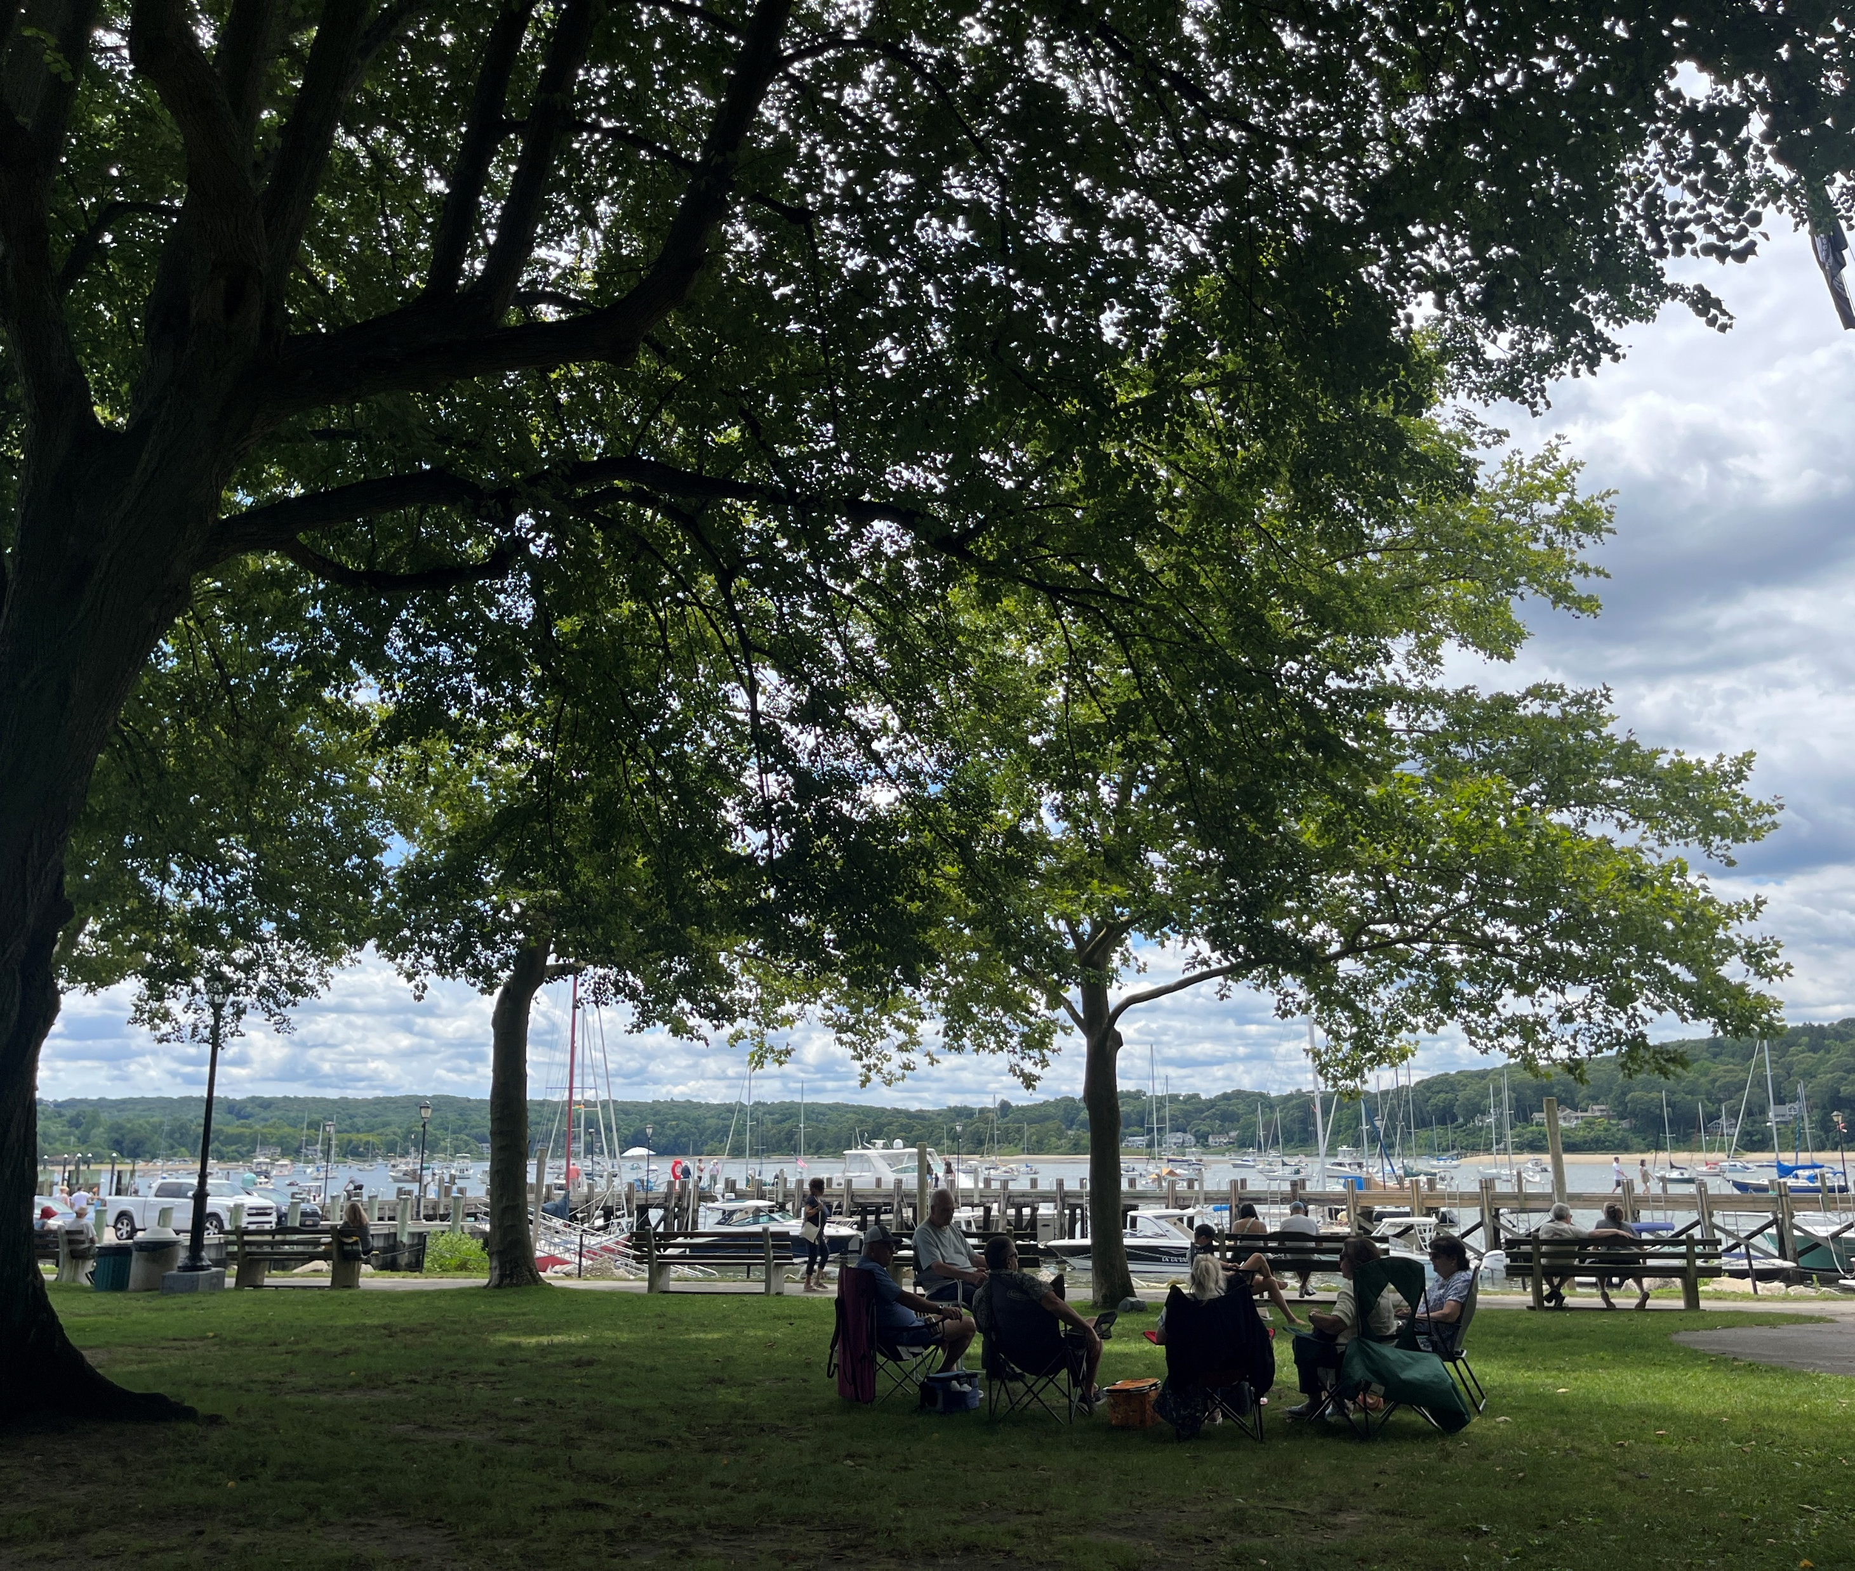
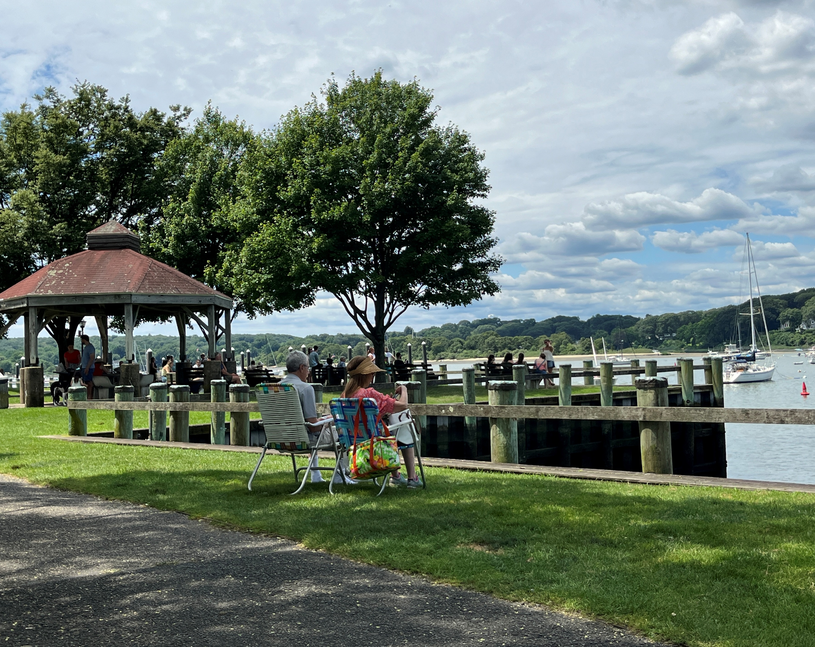
Comprehensive Plan Committee
COMPREHENSIVE
PLAN
TEAM
Board of Trustees
Donna Koch, Mayor
Roland Buzard, Village Administrator/NYSCEO
Richard Boziwick, Trustee
Andy Cangemi, Zoning Board Chair
James Izzo, Chamber of Commerce/ Main Street Proprietor, Licensed Real Estate Broker
John C. Bennett, Esq.
Donna Koch, Mayor
Meghan Dolan, Deputy Mayor
Richard Boziwick, Trustee
Joseph Sabia, Trustee
Dave Weber Jr, Trustee
Consultant Team
Nelson Pope and Voorhis, LLC
Sub-Consultants
KAG Engineering, PLLC
Traffic Data Bank
The Public!

Slide 5
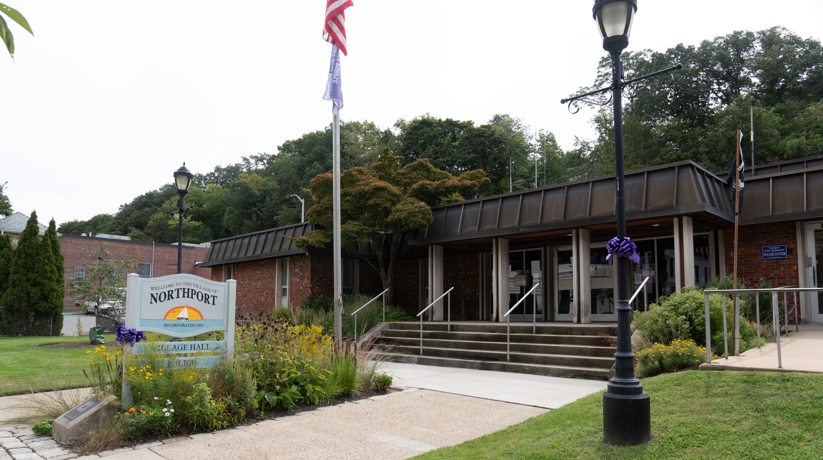
COMMENT PROCESS
The Village of Northport’s DRAFT Comprehensive Plan is now available for review on the Village website. Paper copies are available in Village Hall and at the Library.
The public is welcome and encouraged to submit comments on the Draft Comprehensive Plan via email to nptcomprehensiveplan@northportny.gov
by Friday March 13th .
Public Comment Period is Open!

Slide 6
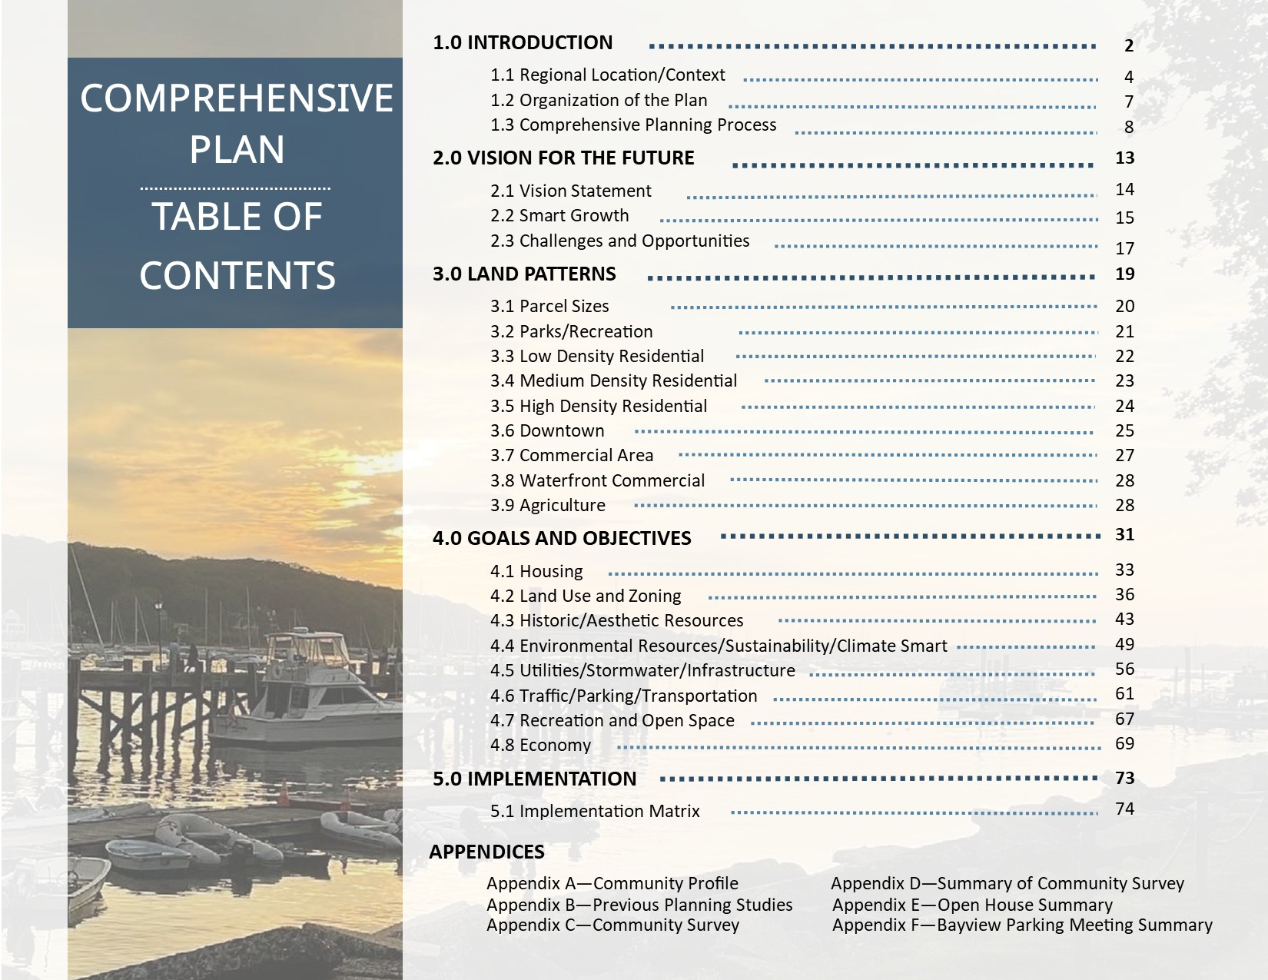
TABLE OF CONTENTS
How Do We Get There?
*Traffic Data Bank’s parking calculations and
KAG Engineering’s transportation report can be found in Appendix A

Slide 7
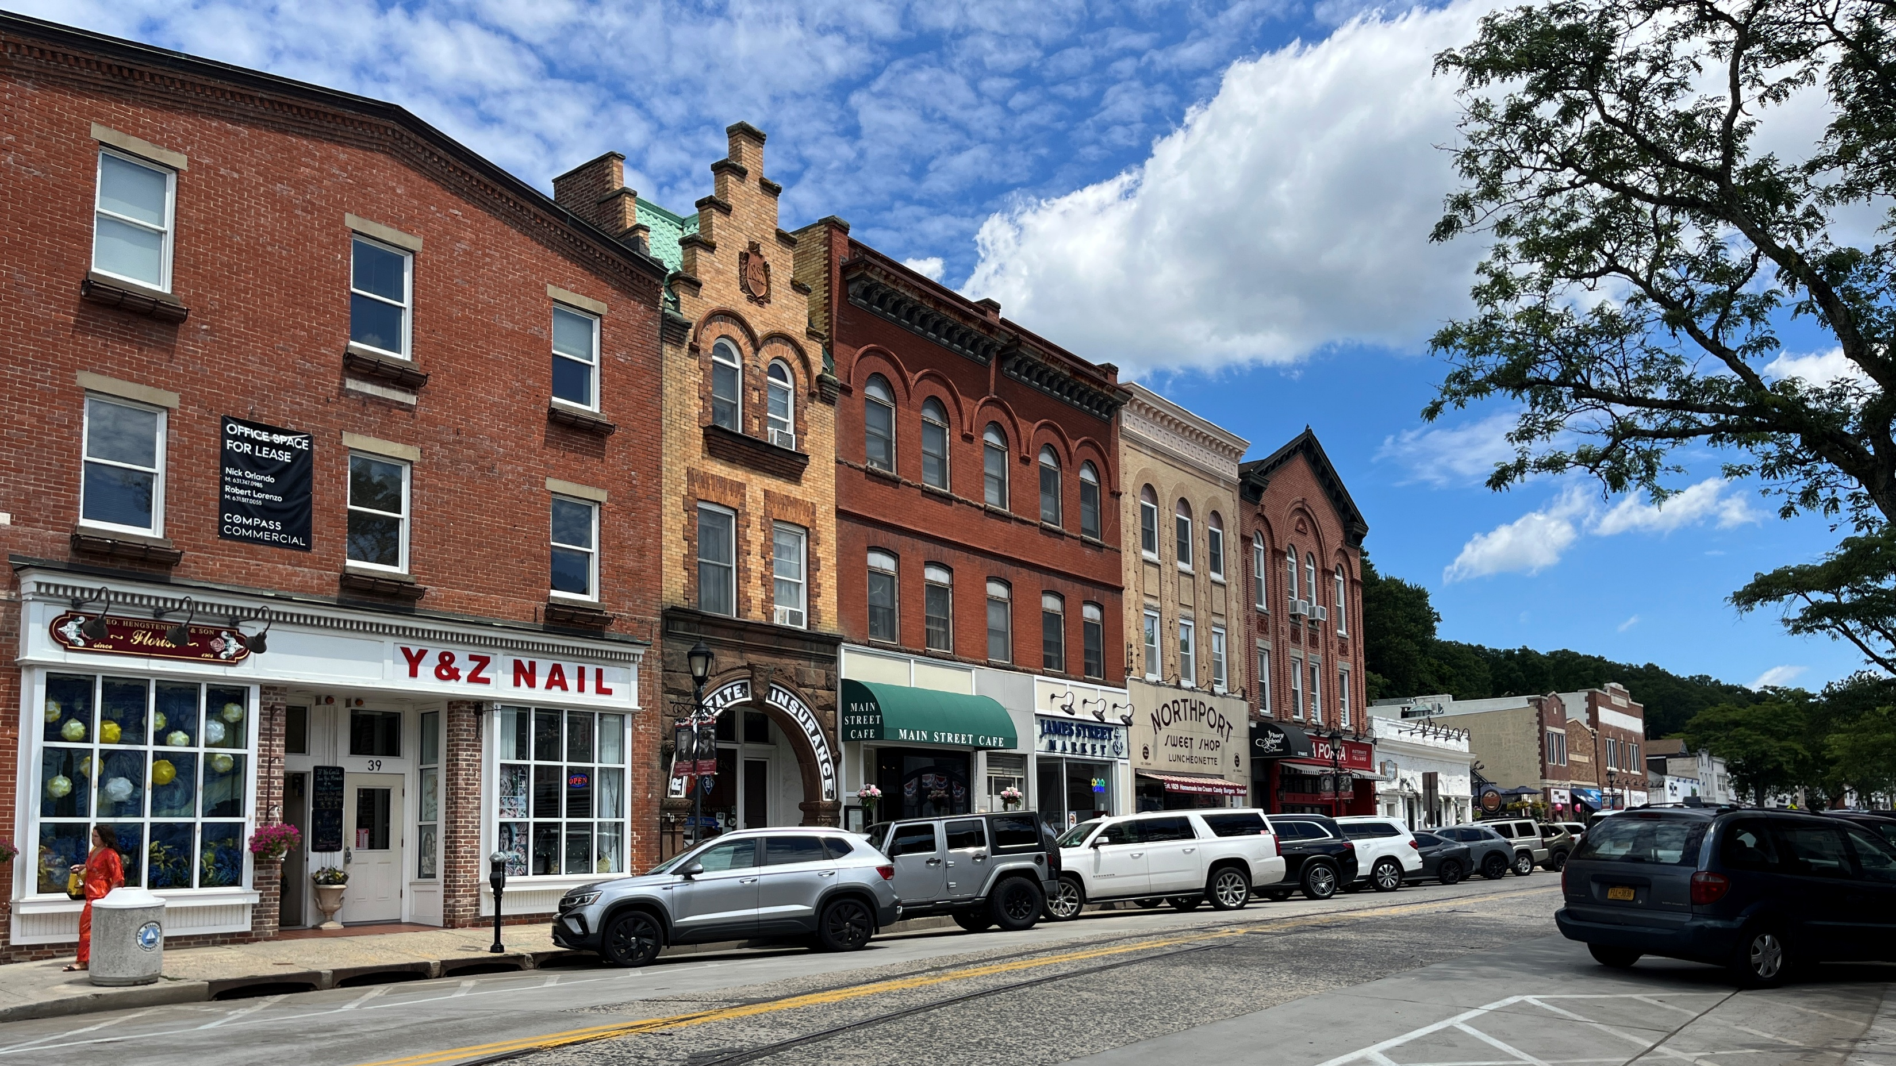
EXISTING CONDITIONS – Community Profile
Where Are We Now?
Demographics
Land Use and Zoning
Housing
Environmental Resources
Transportation
Parking Utilization Study
Community Facilities and Services
Historic and Scenic Resources

Slide 8
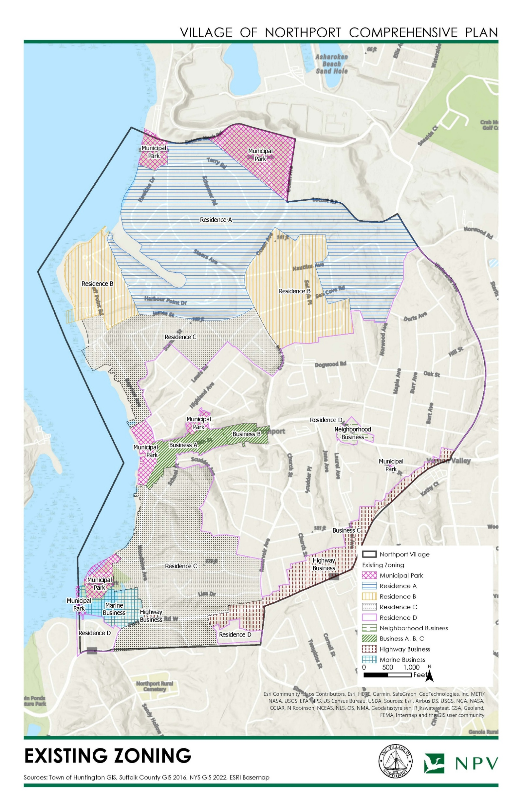
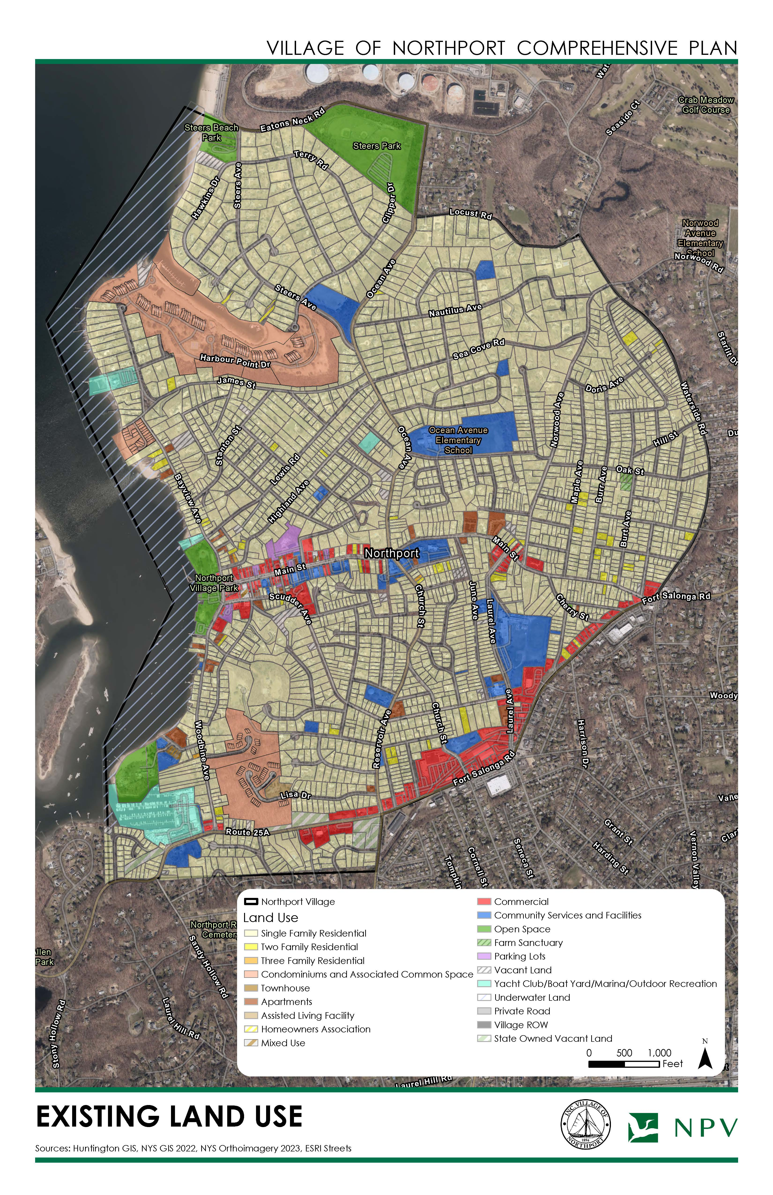
EXISTING
ZONING
EXISTING
LAND USE

Slide 9
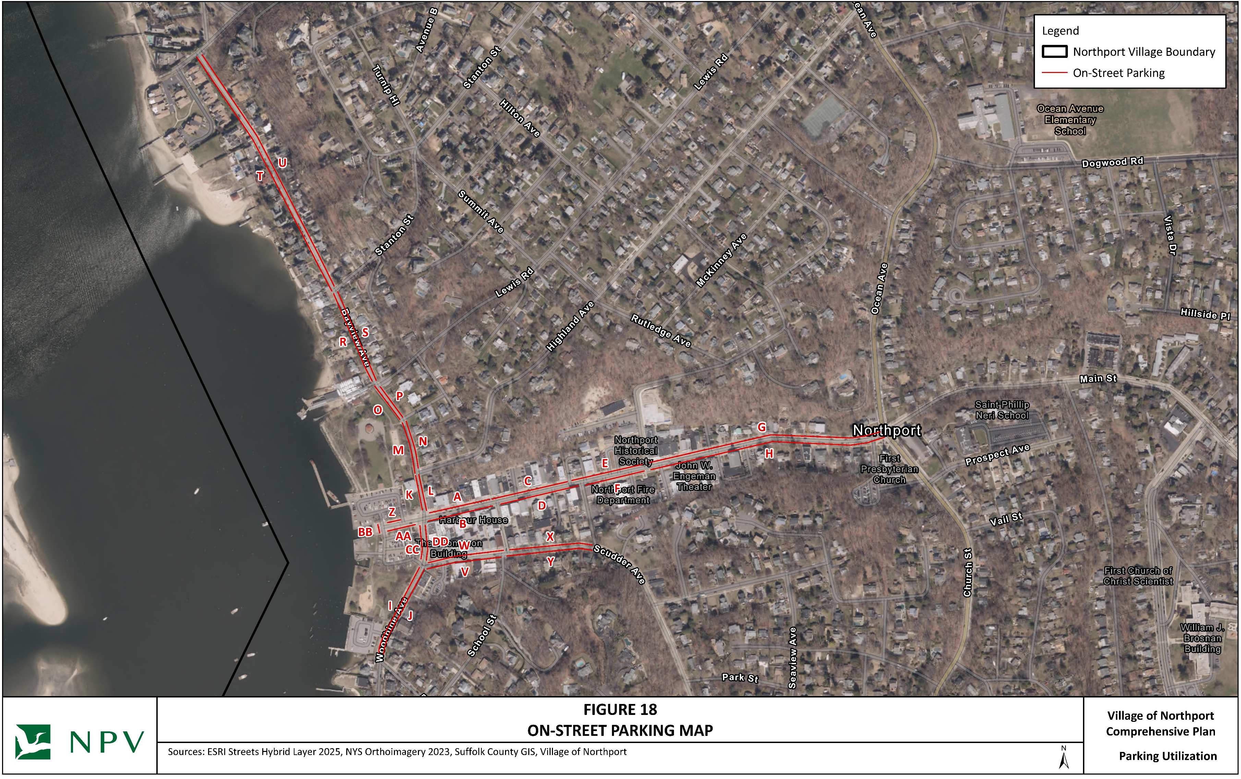
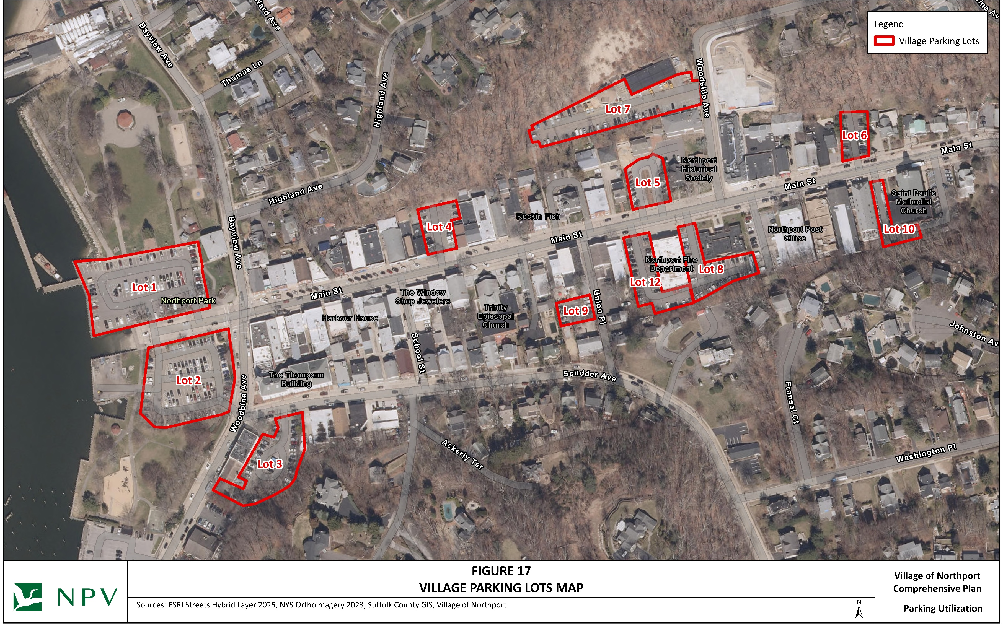
PARKING STUDY
Parking Counts were collected by Traffic Databank (MBE) in all municipal lots and on-street parking within the downtown.
Vehicle counts were recorded on 11/14 and 11/16 once per hour between 8:00 am - 8:00 pm.
Table of Contents
Public Parking Lots
On Street Parking
Parking Accumulation Data

Slide 10
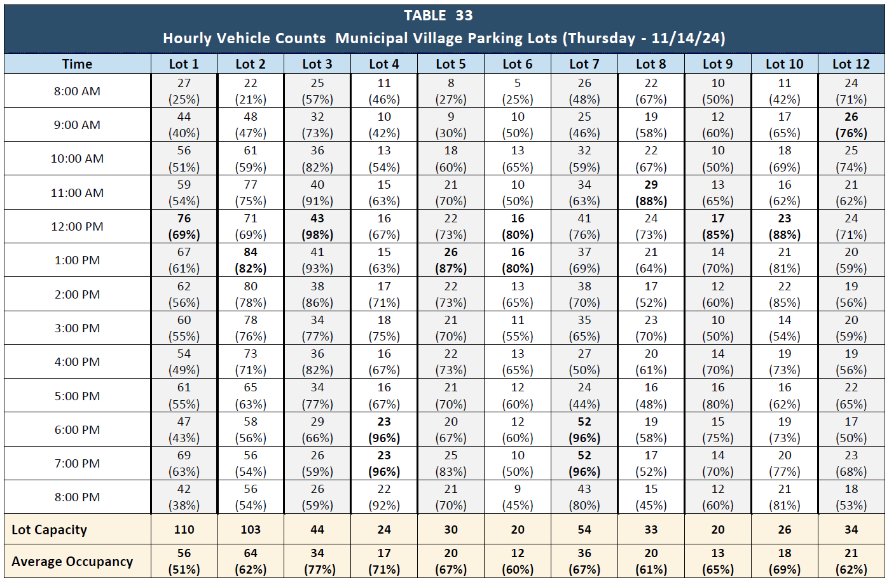
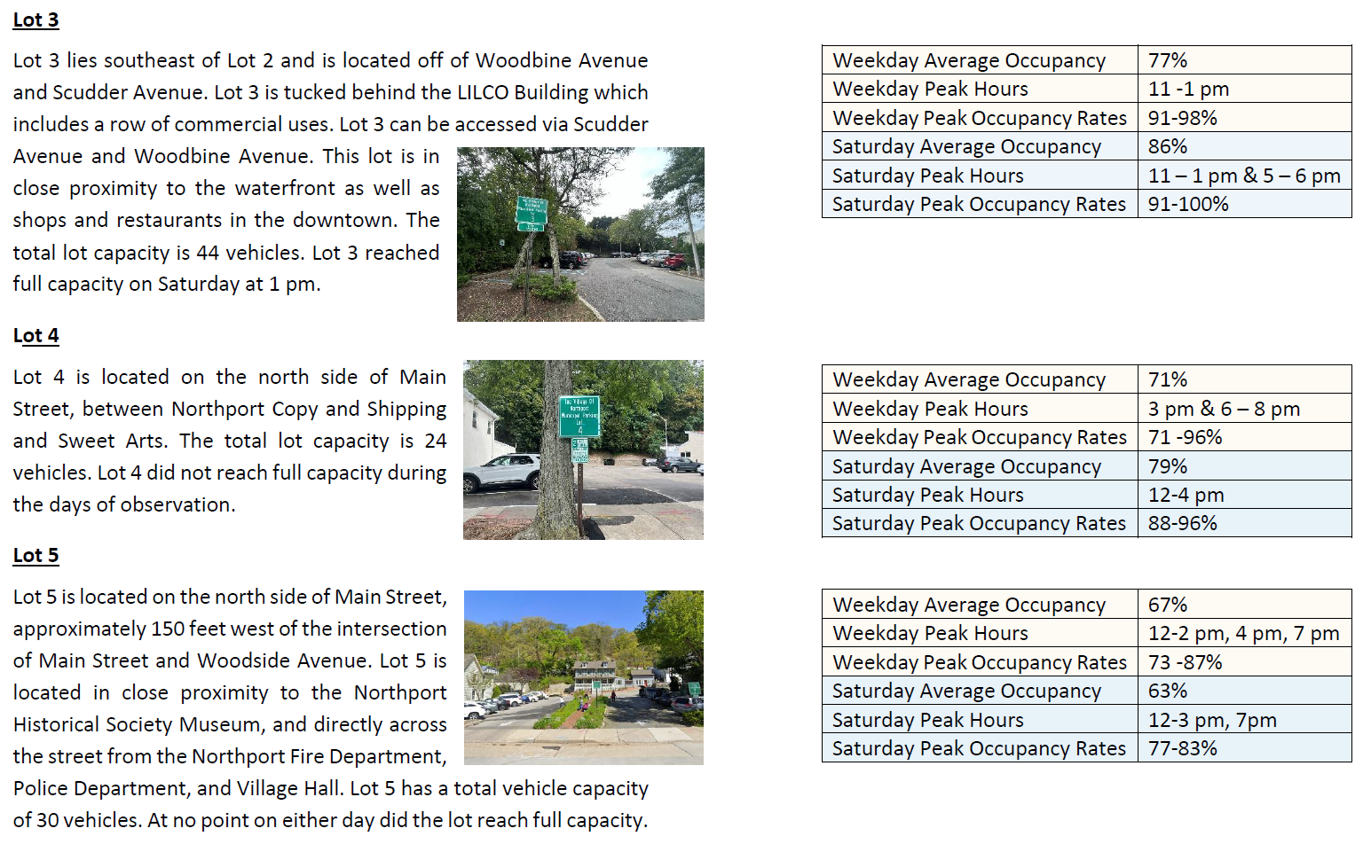
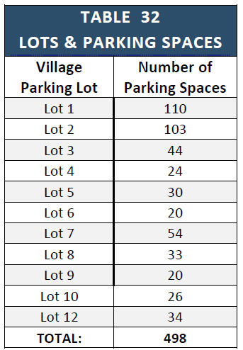
PARKING STUDY
Public Parking Lots

Slide 11
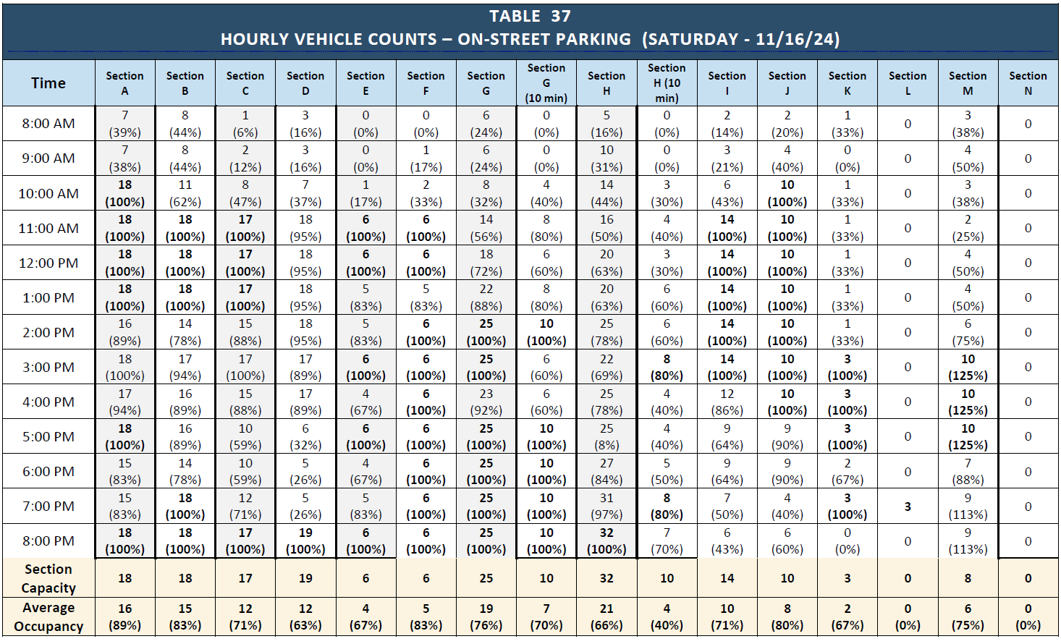
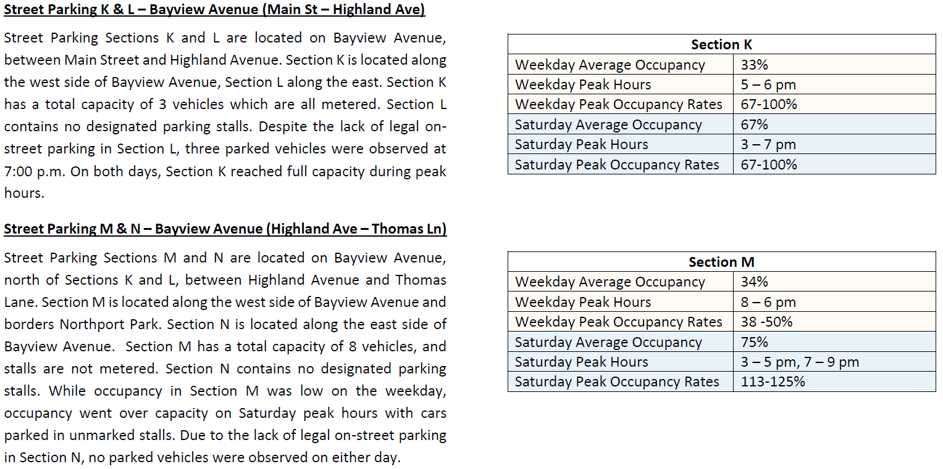
PARKING STUDY
On-Street Parking
Parking counts were conducted across 29 on-street parking sections within the Village of Northport downtown area, labeled Sections A through DD. 331 on-street parking stalls were analyzed.

Slide 12
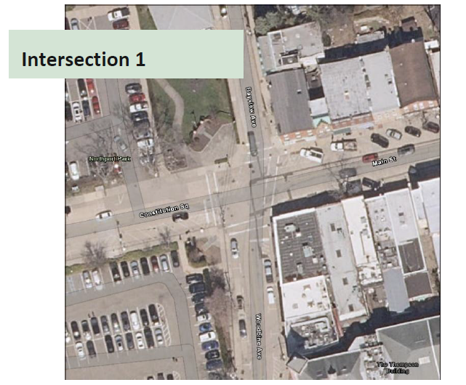
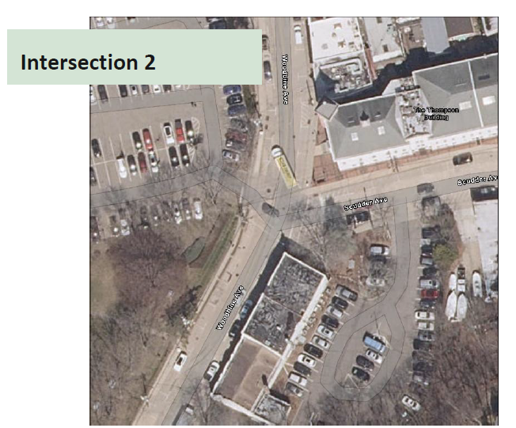
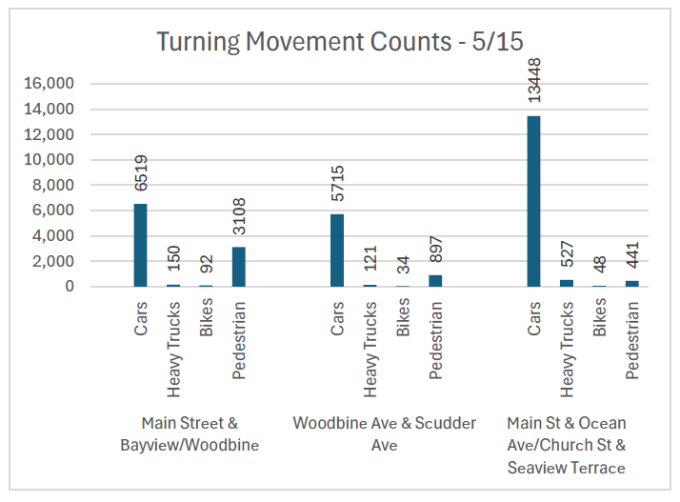
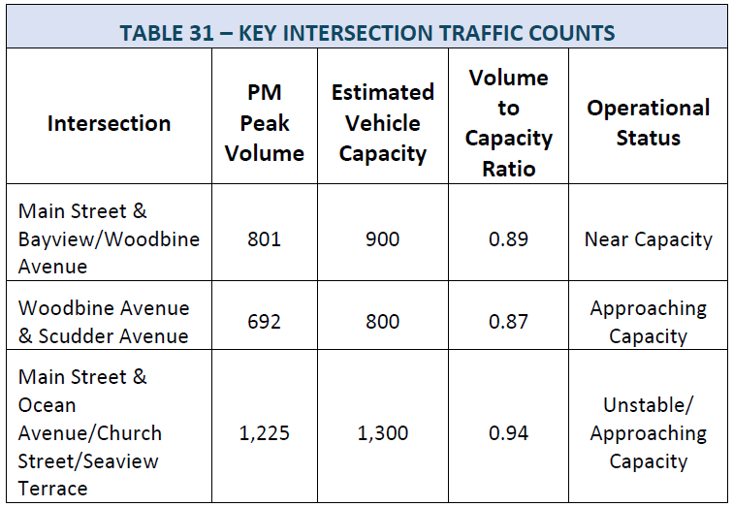
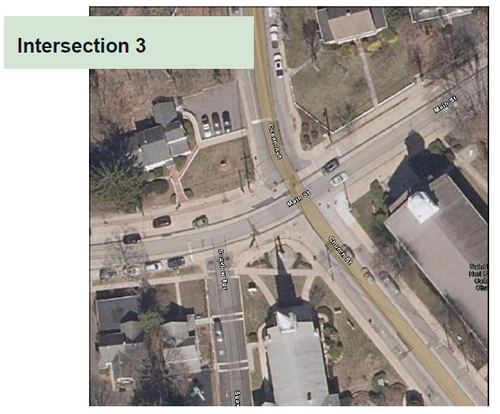
TRANSPORTATION STUDY
The Transportation Study was conducted by KAG Engineering (WBE) including traffic counts at key intersections.
The three intersections analyzed include:
o Intersection 1: Main Street & Bayview/Woodbine Avenue
o Intersection 2: Woodbine Avenue & Scudder Avenue
o Intersection 3: Main Street & Ocean Avenue/Church Street & Seaview Terrace
Turning Movement Count Data
KAG Engineering collected turning movement counts at three different intersections on May 15th and May 17th between the hours of 5:00 am and 9:00 pm.
Table of Contents
Transportation Planning
Commuting Patterns
Roads
Public Transportation
Pedestrian Systems
Parking
Transportation Study
Methodology
Intersections
Turning Movement Counts
Turning Movement Count Analysis
Turning Movement Count Conclusions
Overall Network Conclusions
Key Issues
Turning Movement Count Analysis

Slide 13
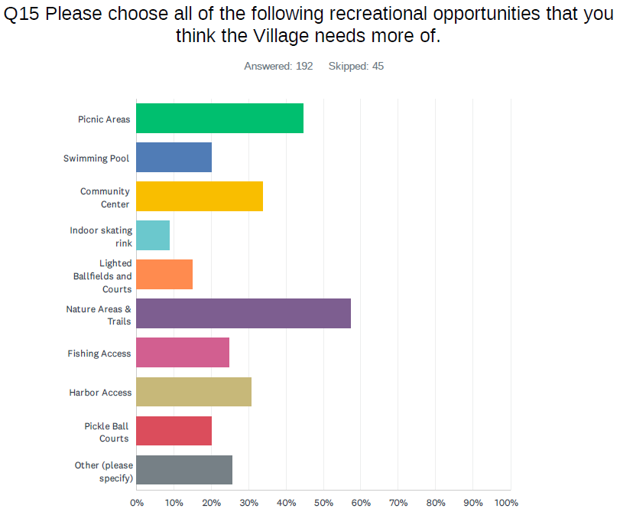
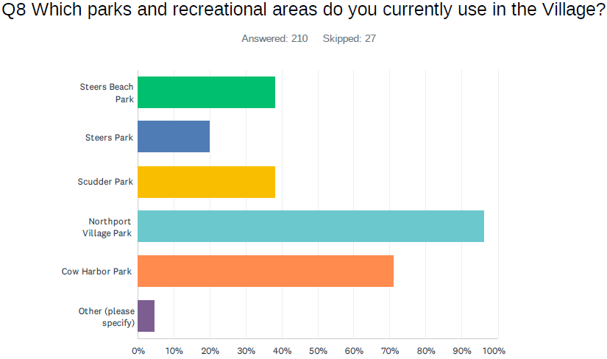
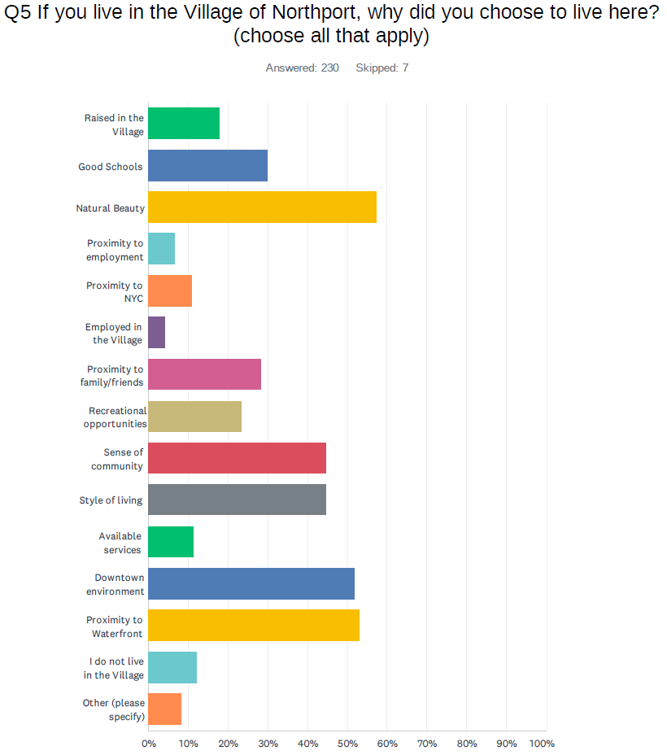
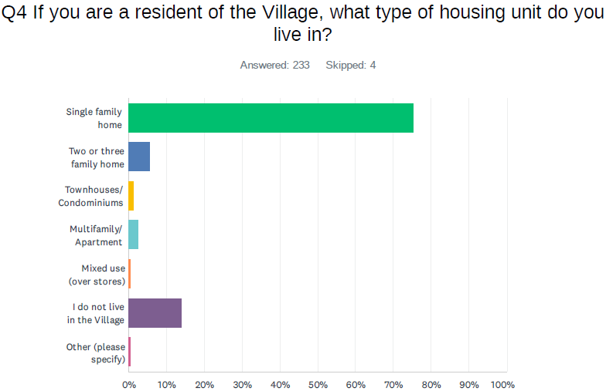
Community Survey
PUBLIC PARTICIPATION
Where Are We Going?
NPV, in conjunction with the Comprehensive Plan Committee, circulated a survey to the community. The survey was primarily web-based; although, paper copies were available at Village Hall and the Library. The survey was conducted from March 24, 2024 through June 3, 2024 and a total of 237 responses were received. The survey posed a series of questions about the Village including topics regarding basic demographics about the respondent (if they live in the Village, for how long, age, housing type), strengths and weaknesses of the Village, priorities and vision for the Village, challenges the Village is facing, desired parks and recreation improvements, and housing needs.

Slide 14
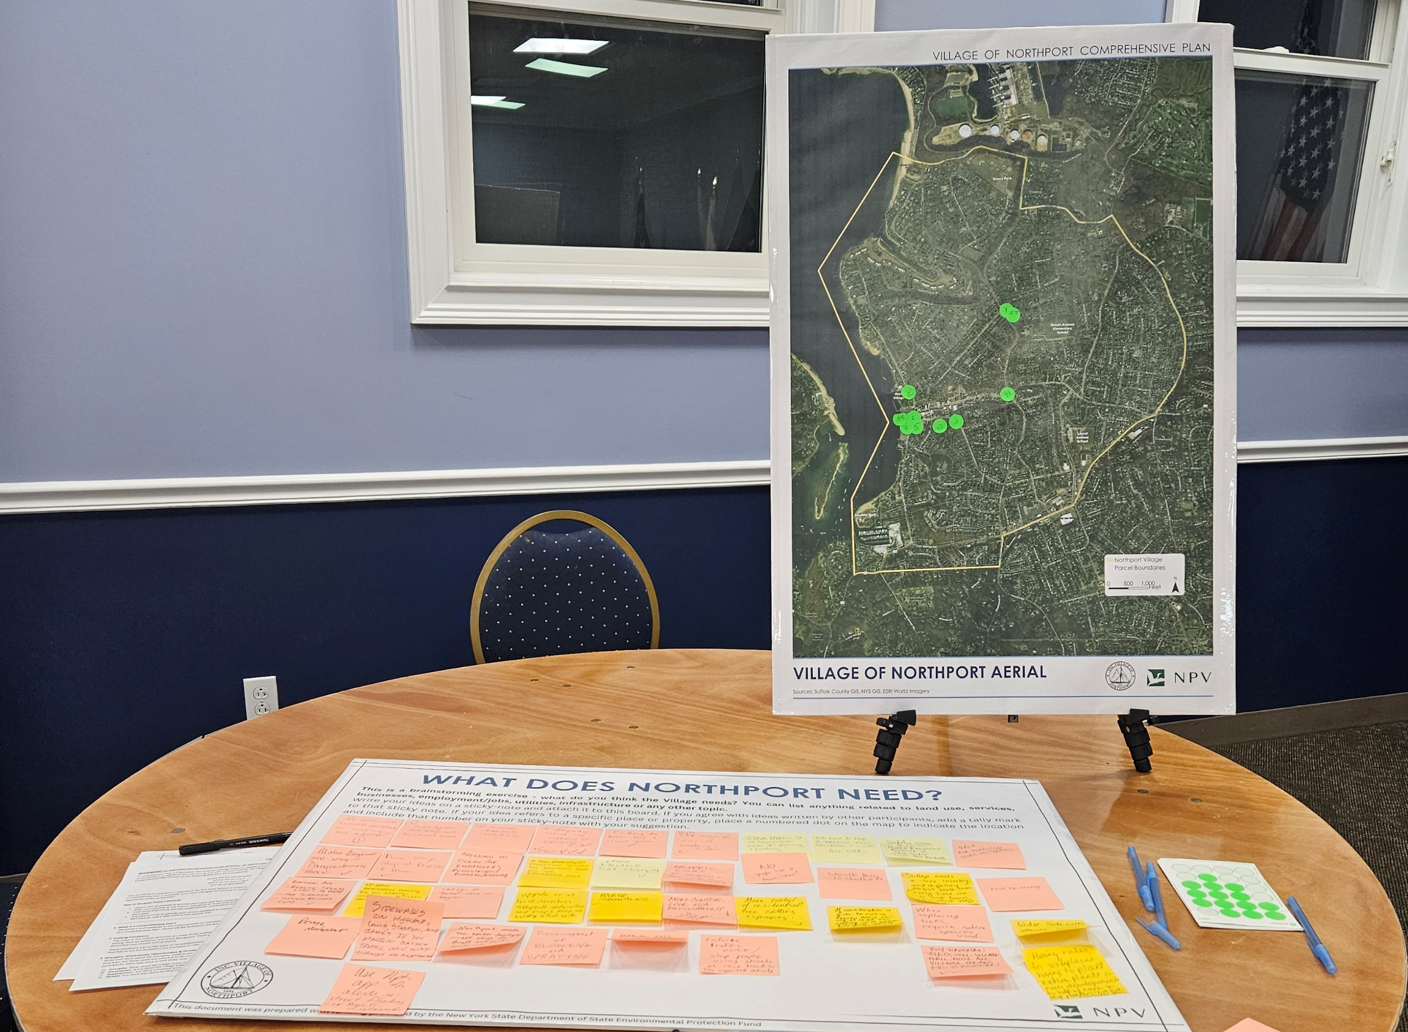
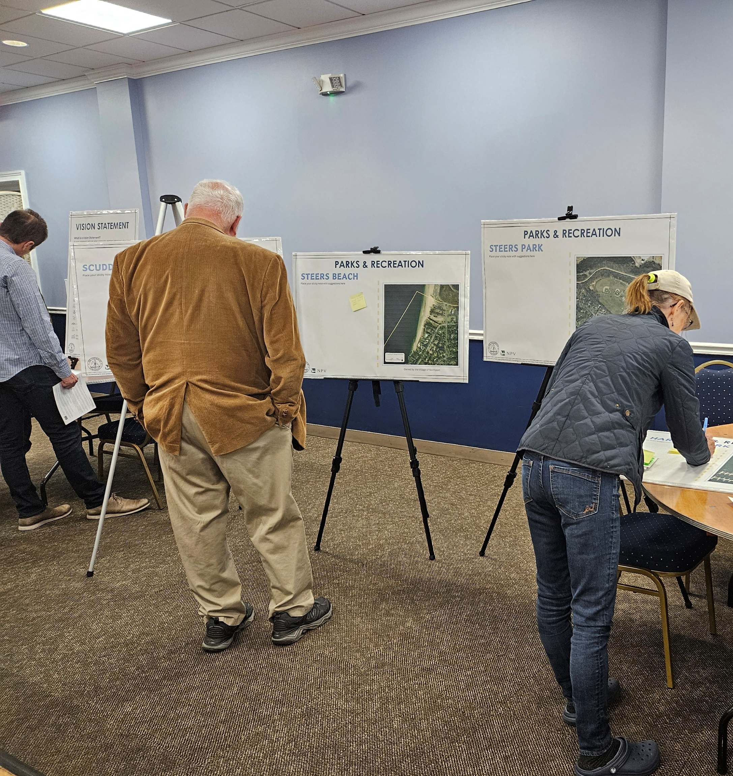
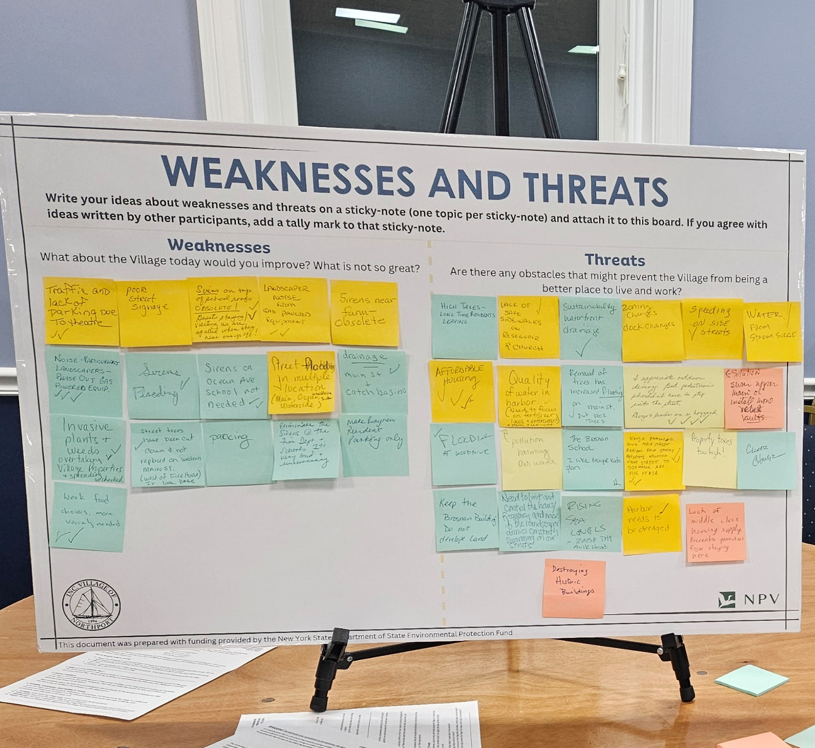
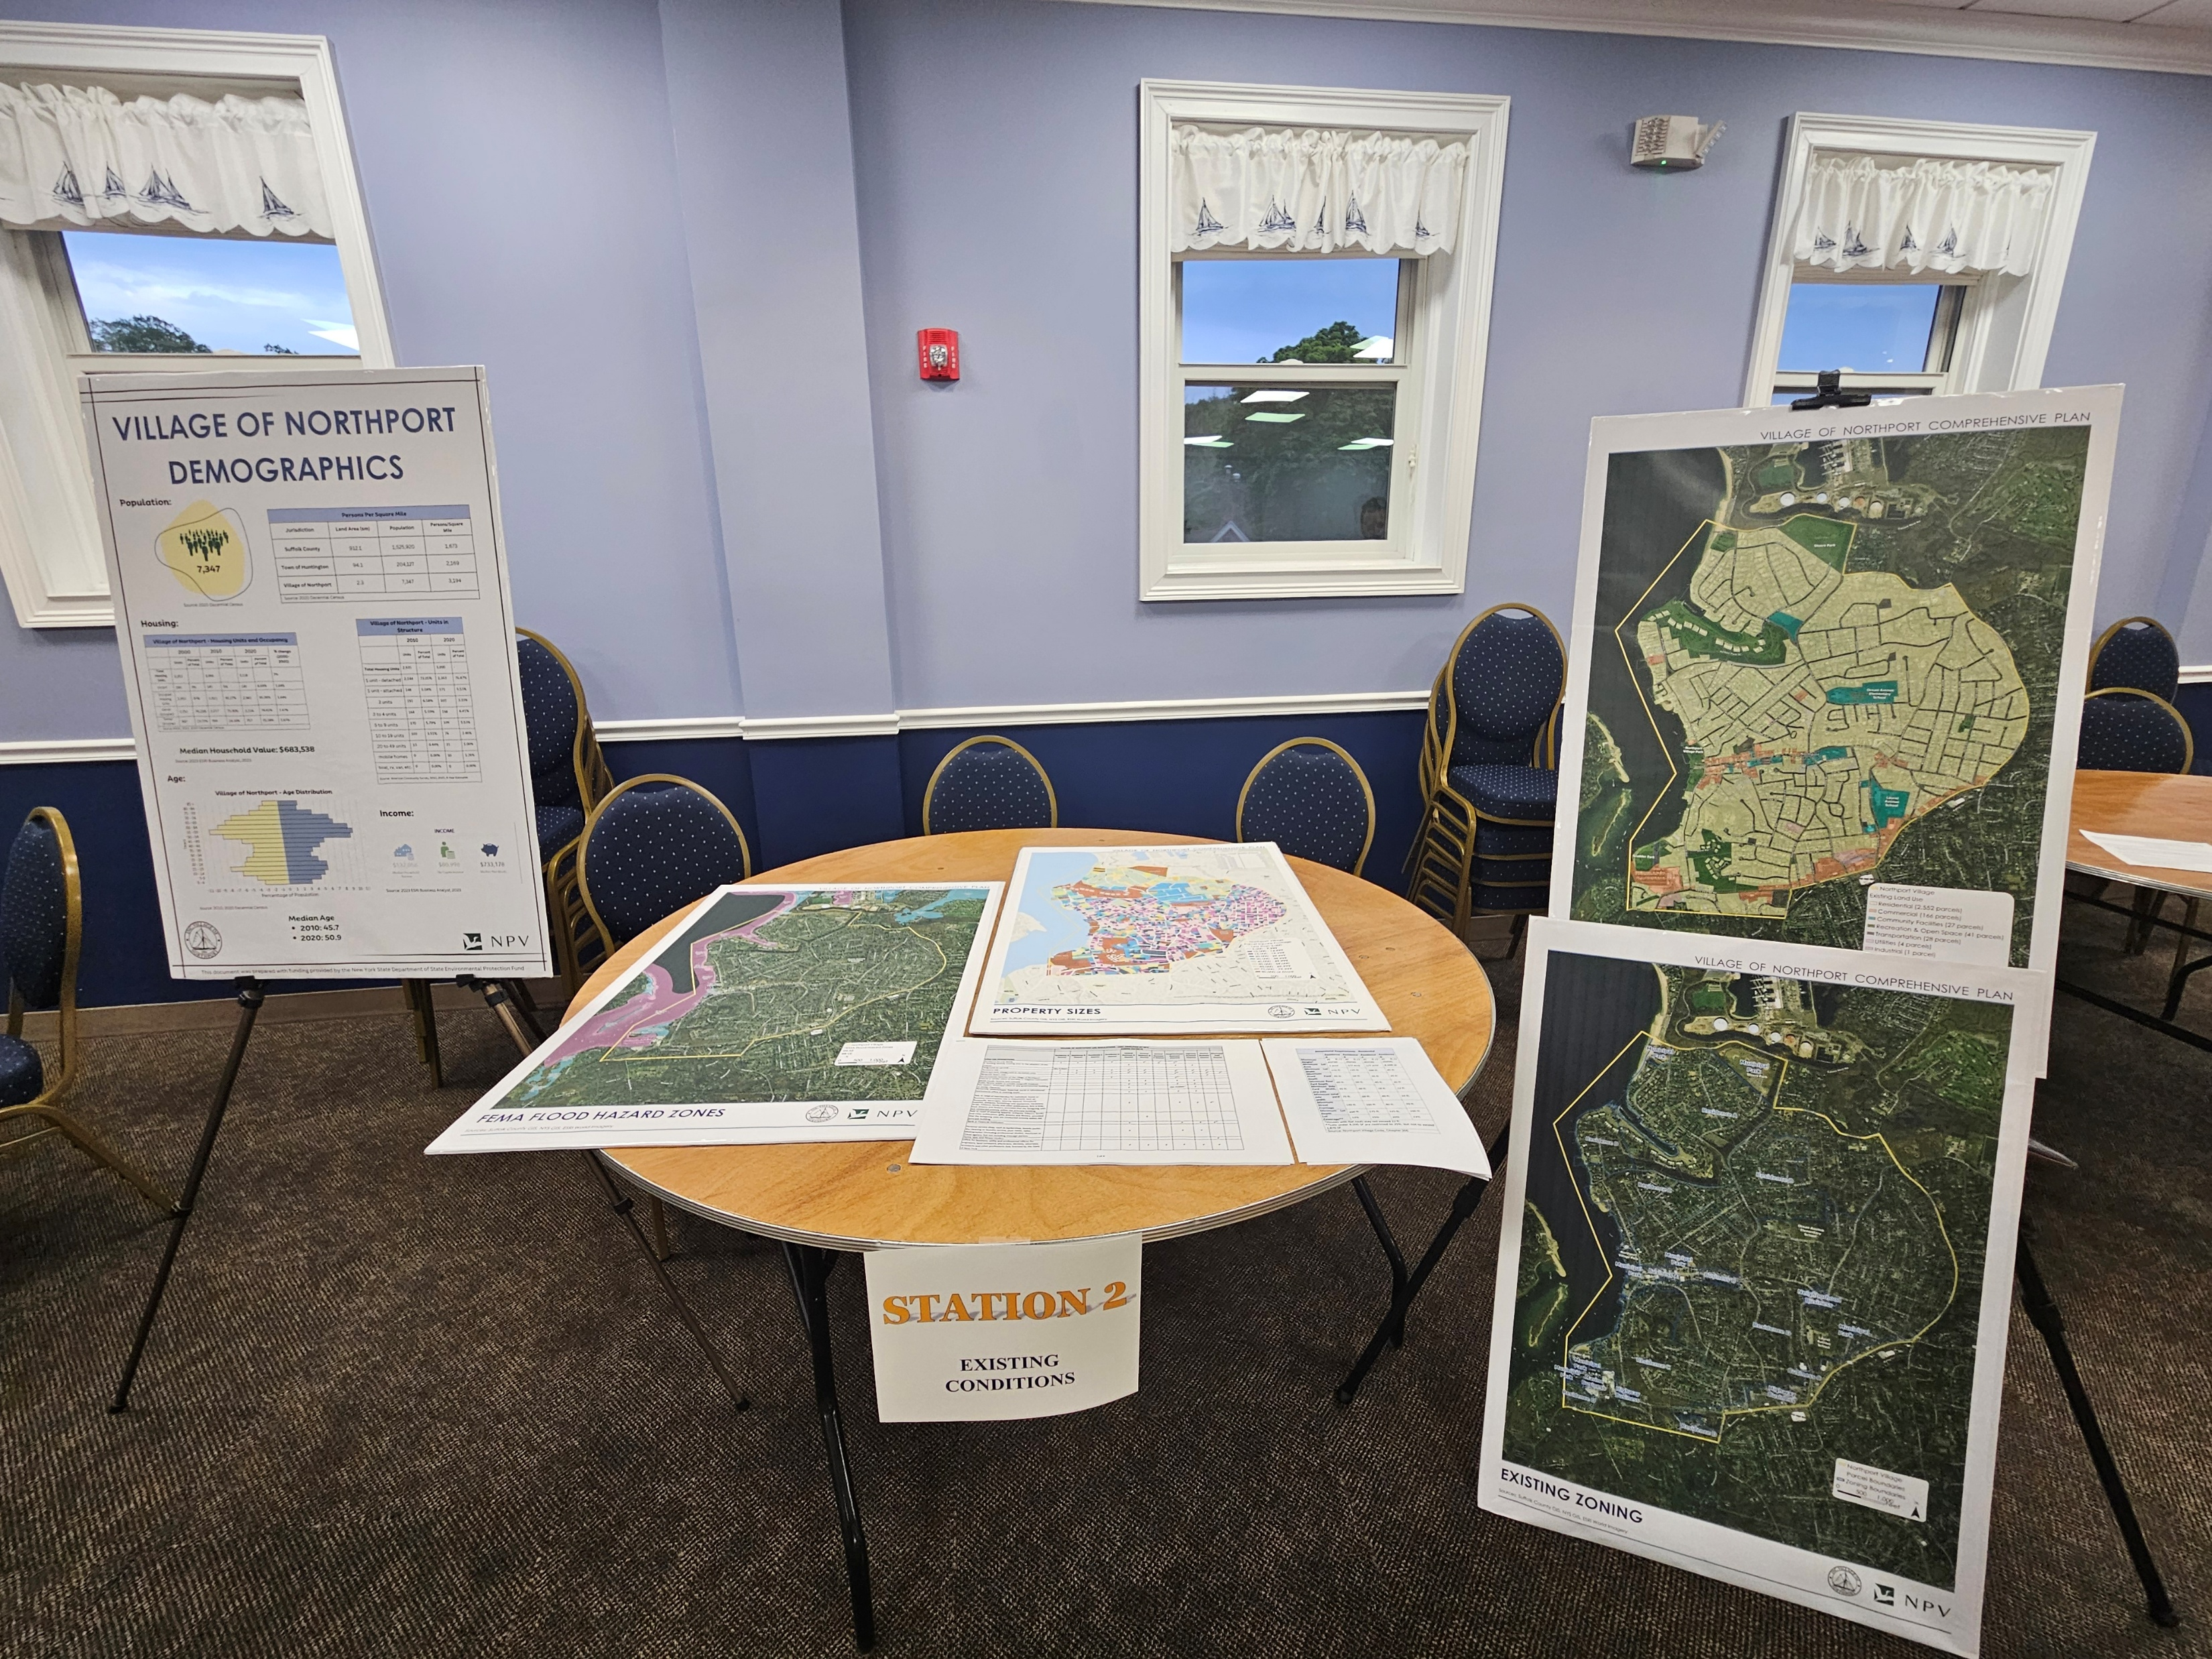
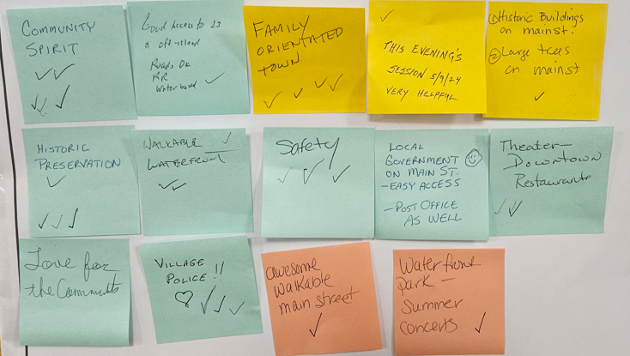
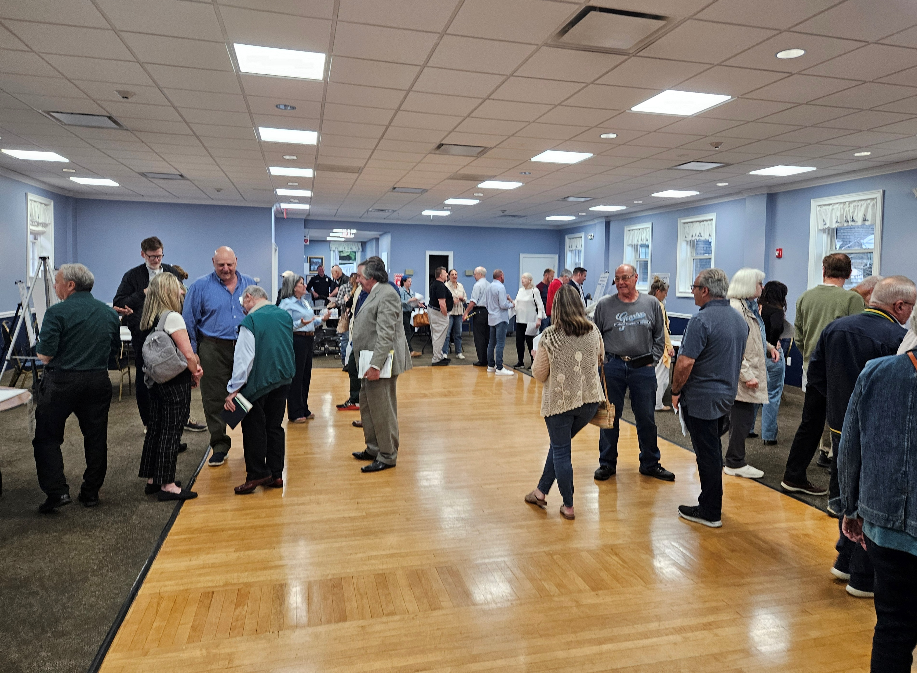
Open House
PUBLIC PARTICIPATION
Where Do We Want To Be?
An Open House was held on May 9, 2024 with approximately 60 attendees and featured the following stations:
What is a Comprehensive Plan?
Existing Conditions (Land Use, Zoning, FEMA, Property Sizes)
Strengths, Weaknesses, Opportunities, and Threats Analysis (SWOT)
What Does Northport Need?
A Vision for Northport
Parks and Recreation
Survey Station (optional station with laptops for participants to take the online survey)

Slide 15
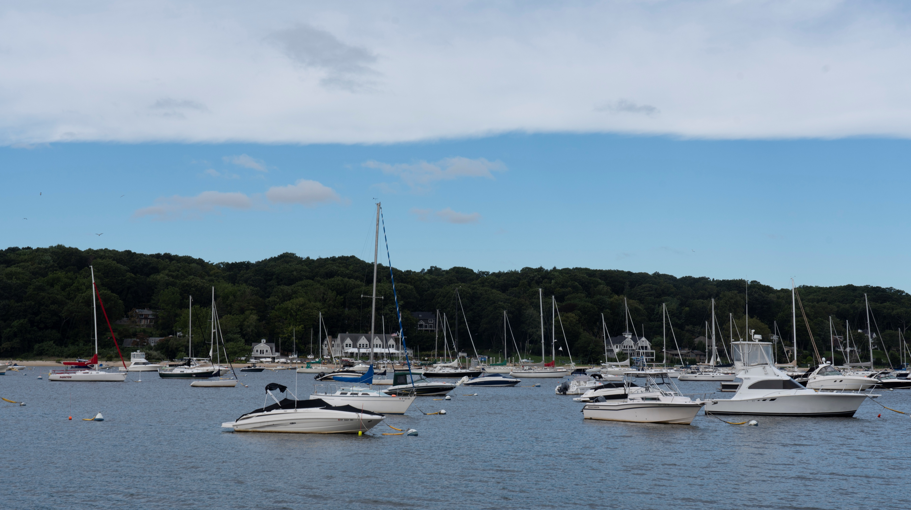
VISION STATEMENT
The Village of Northport is a historic maritime village on the north shore of Long Island, in Suffolk County. The Village is defined by its unique history and culture, architecture, tree-lined streets, and scenic waterfront. The Harbor and the adjoining downtown are central to the Village’s history, unique identity, and current building patterns. The quality of life in the Village is evidenced by the generations of families who call it home. The Vision for the Village is to protect and preserve the intimate nautical atmosphere, excellent quality of life, and community integrity while embracing future demographic needs. In the next 10 years, the Village of Northport will continue to evolve in a sustainable manner by:
protecting its defining historic, cultural, architectural, natural and scenic resources
preserving existing open space
providing additional recreational opportunities
protecting the Harbor and improving stormwater management
maintaining a family-oriented environment
increasing access to the Harbor
encouraging complete streets that are accessible, safe, and comfortable for everyone
planning to maintain the visibility of the downtown while ensuring development does not change the character of the business area
ensuring the overall beauty and character of the Village is maintained for future generations.

Slide 16
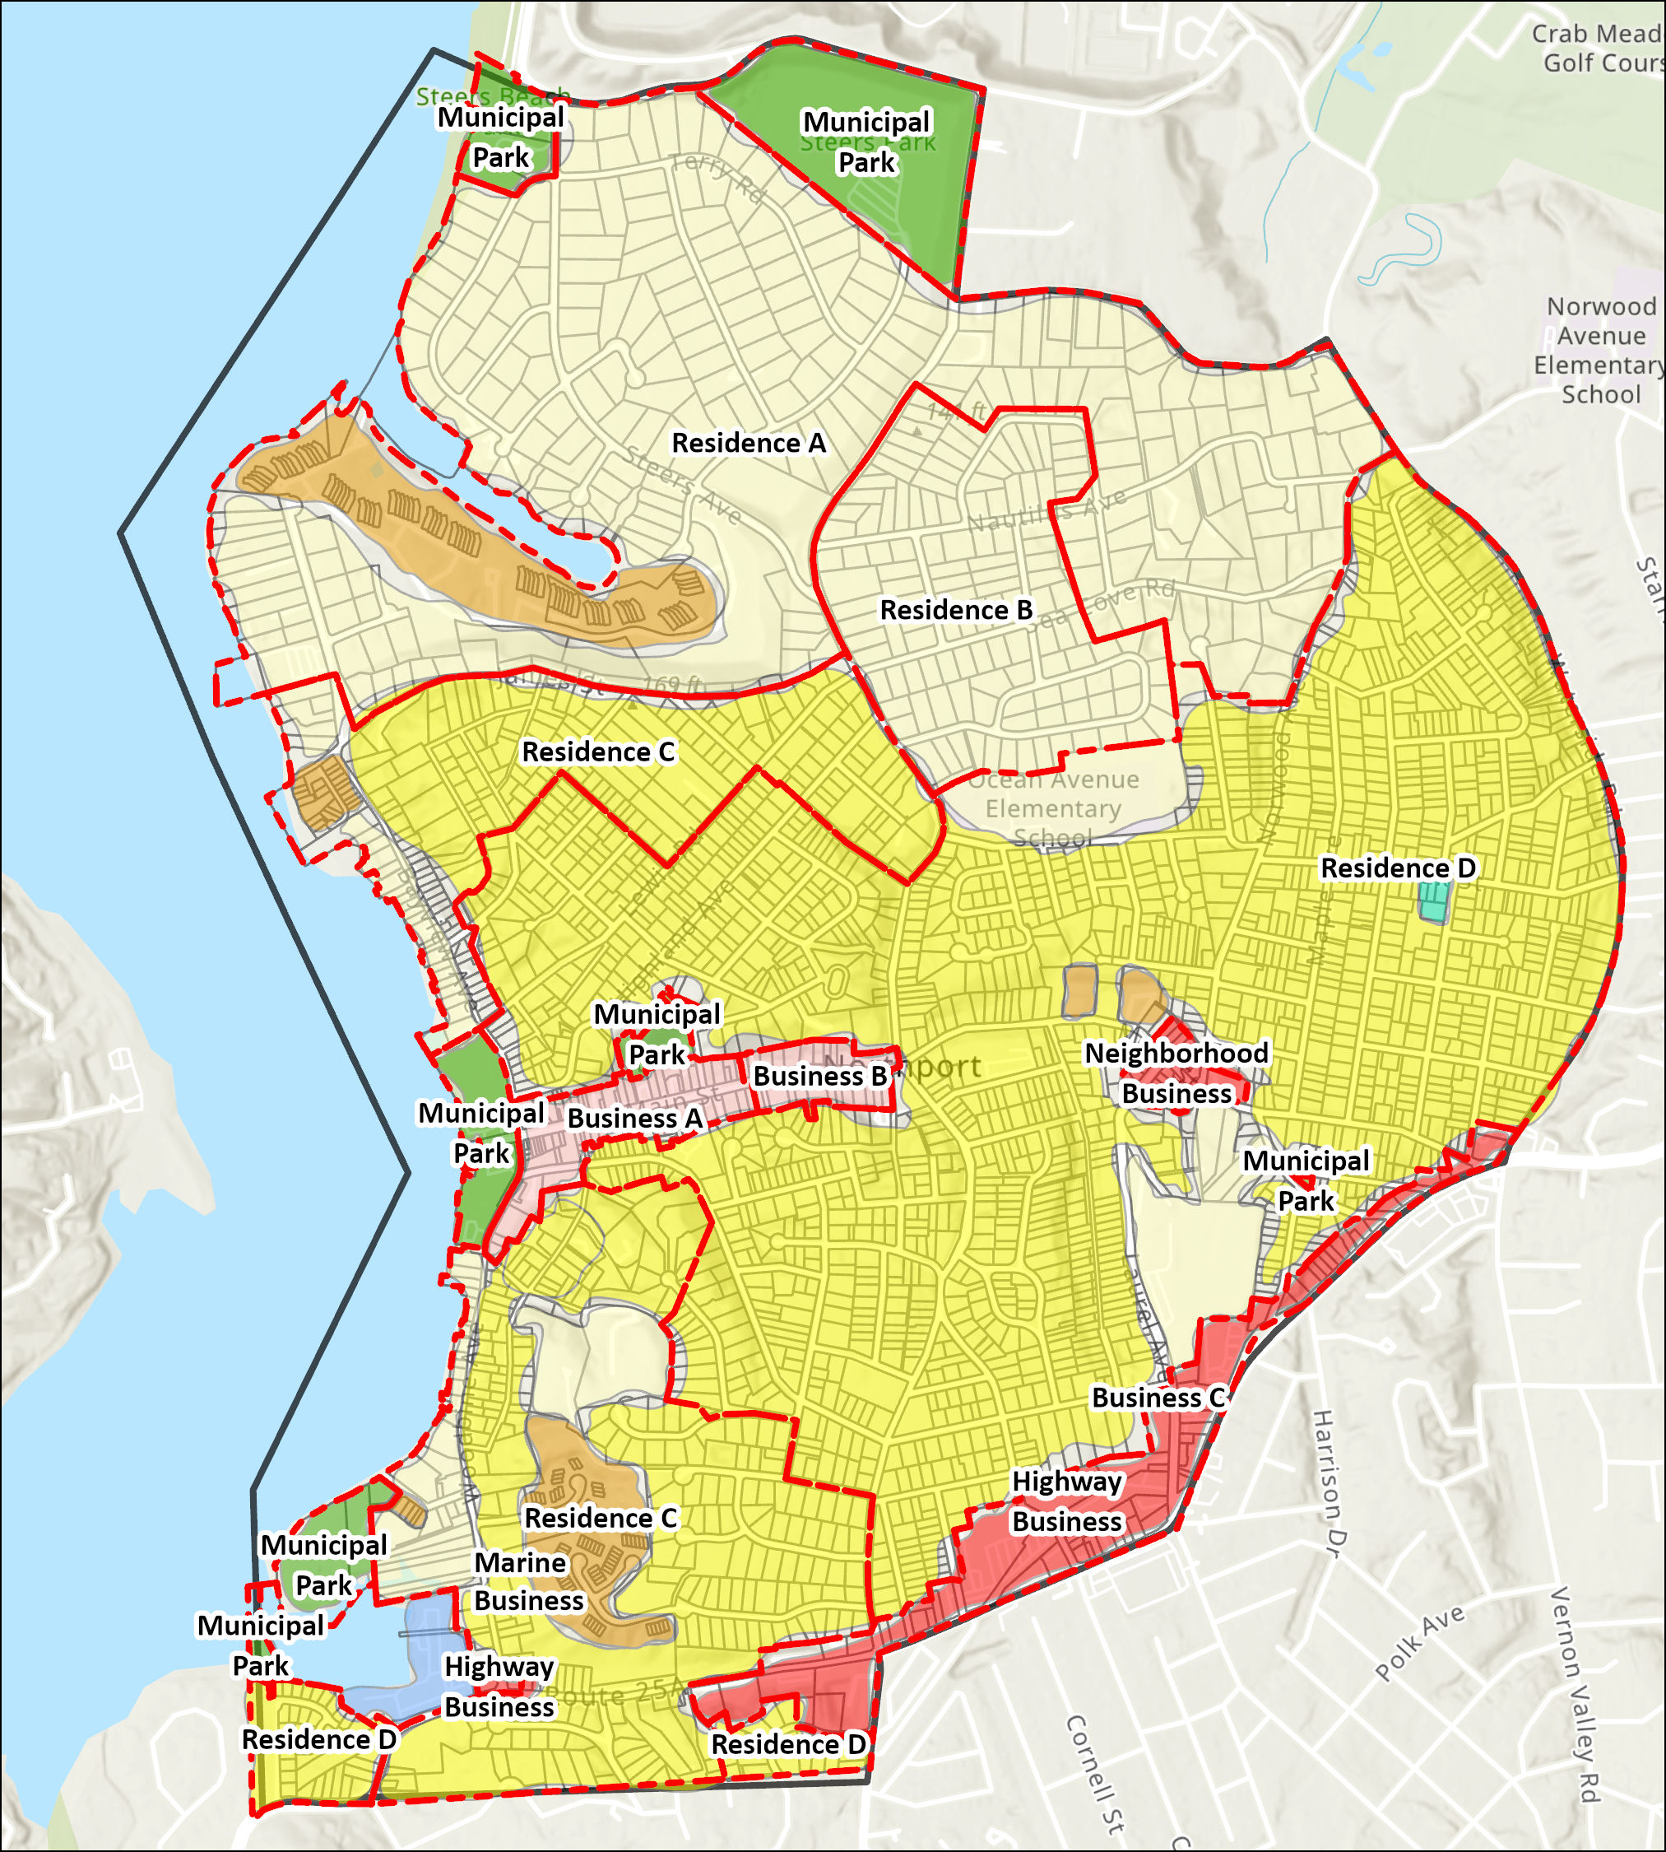
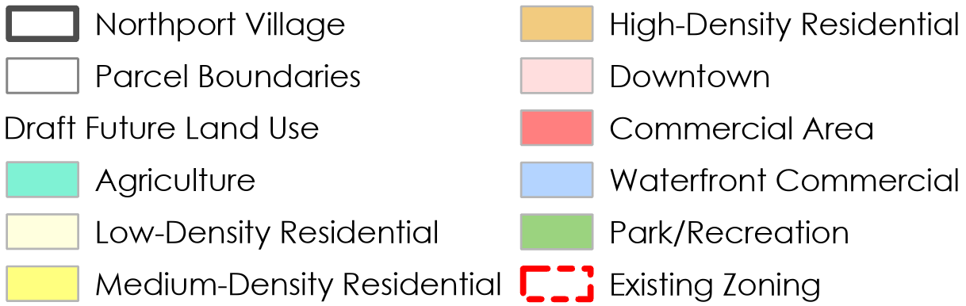
CONCEPTUAL
LAND USE MAP
The Conceptual Land Use Plan for Northport serves as the basis for the Village's long term future growth and development, consistent with the expressed Vision Statement for the Village. Inherent to the community’s expressed preferences is to retain the current building scale and uses to be consistent with the existing built environment and community character.

Slide 17
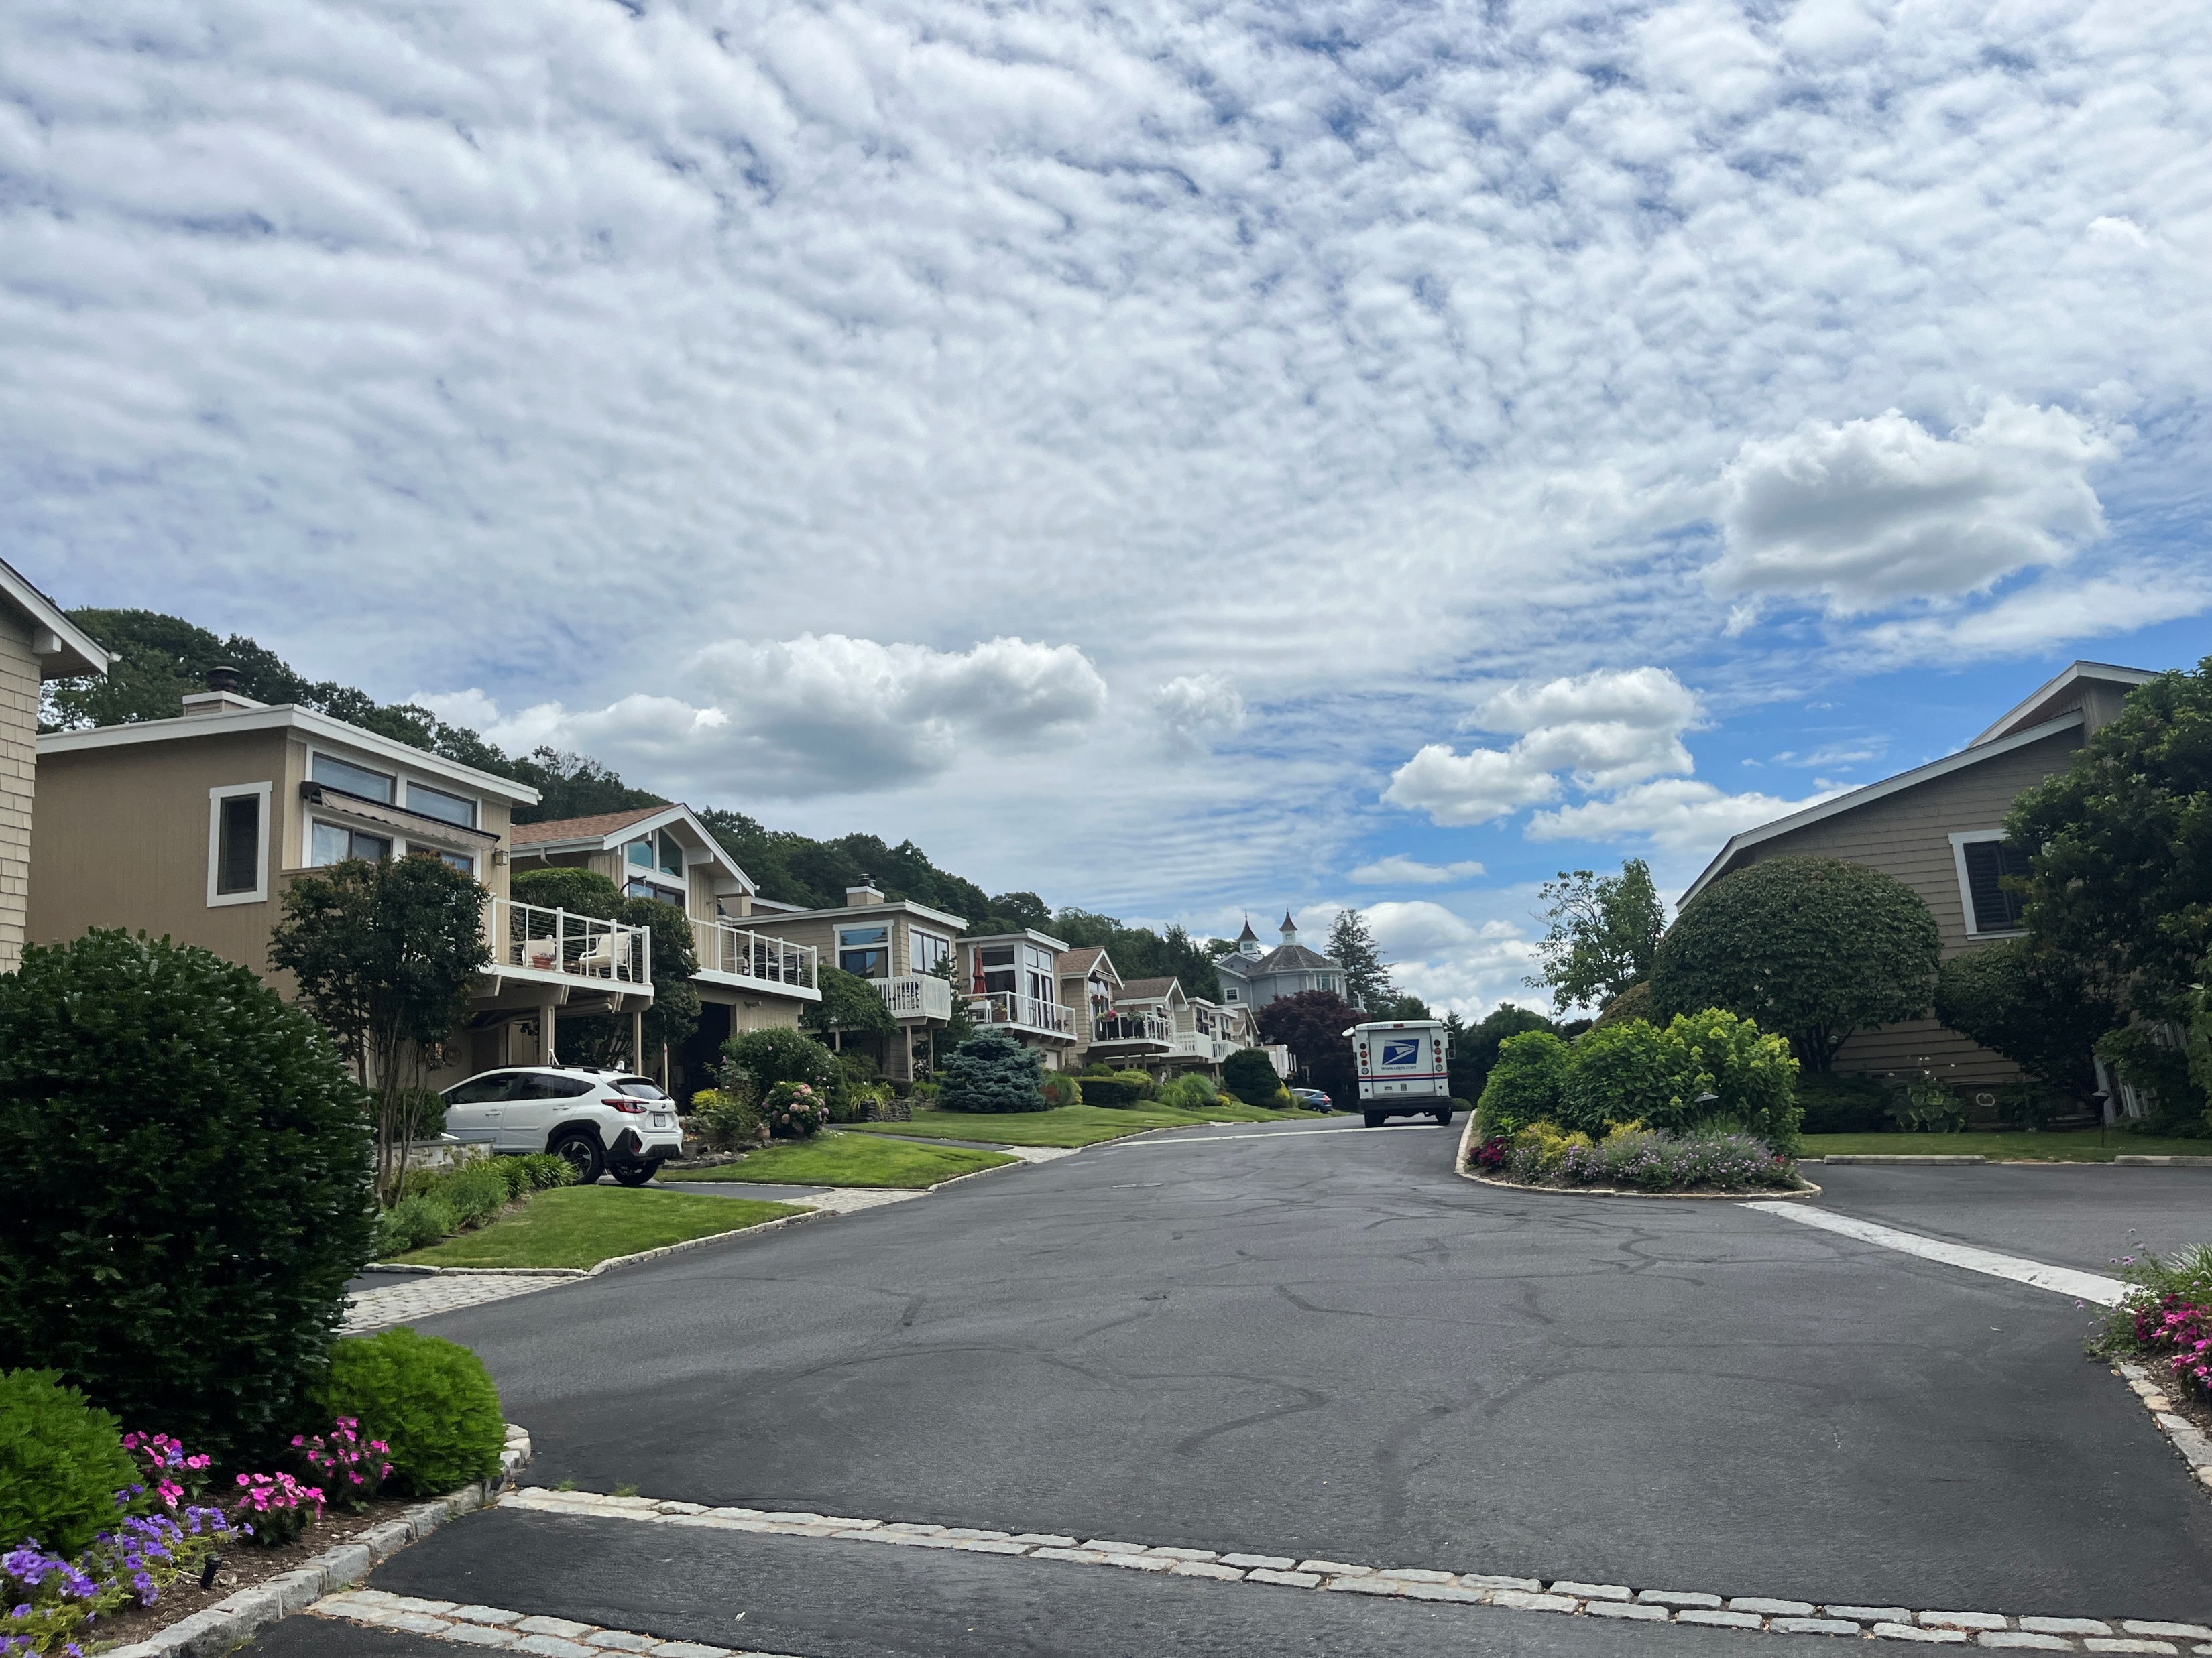
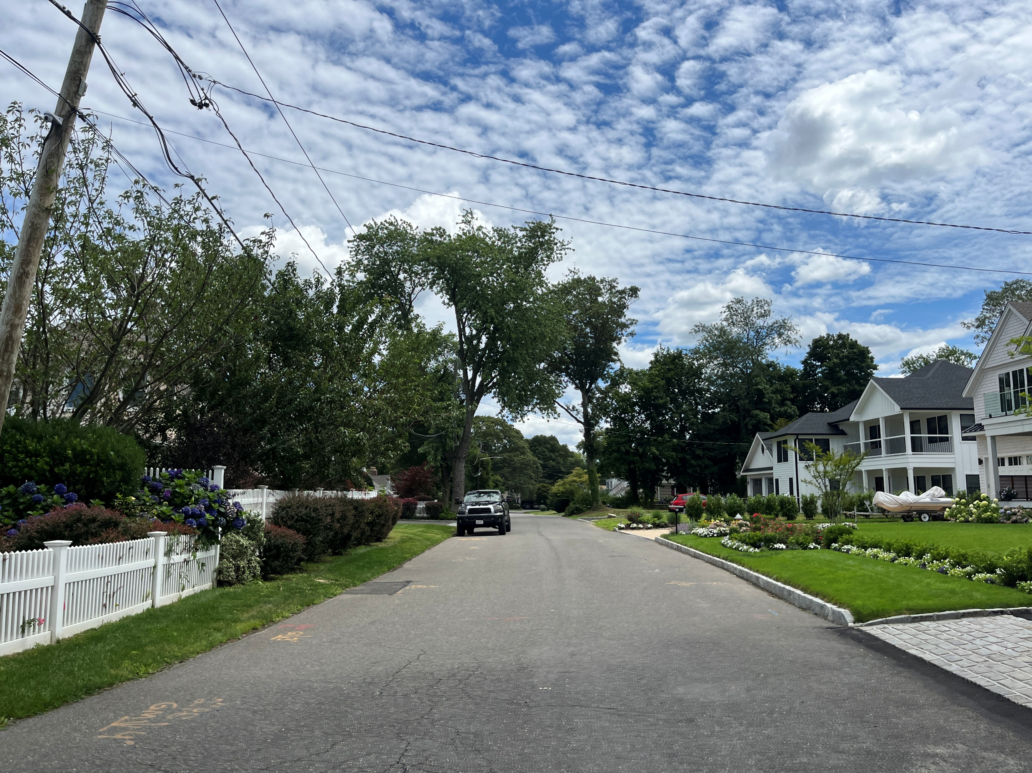
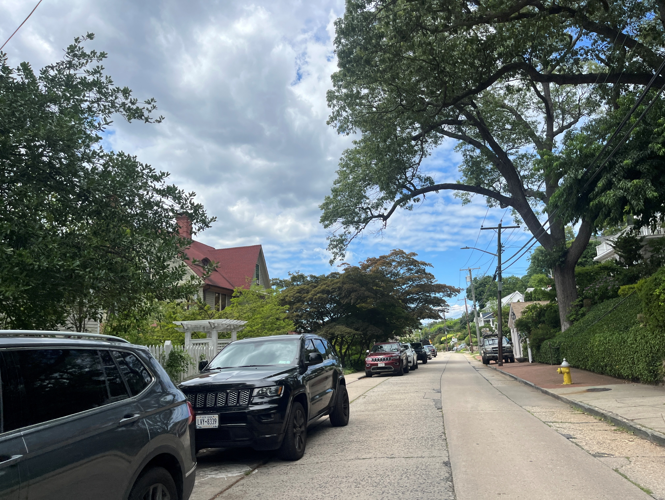
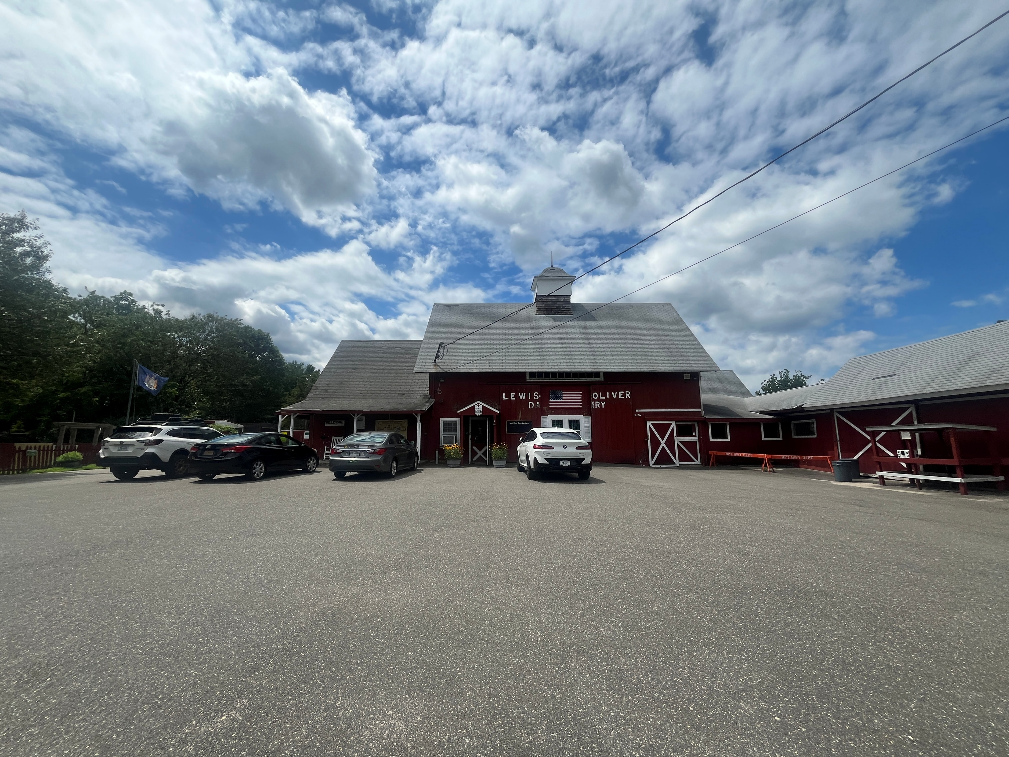
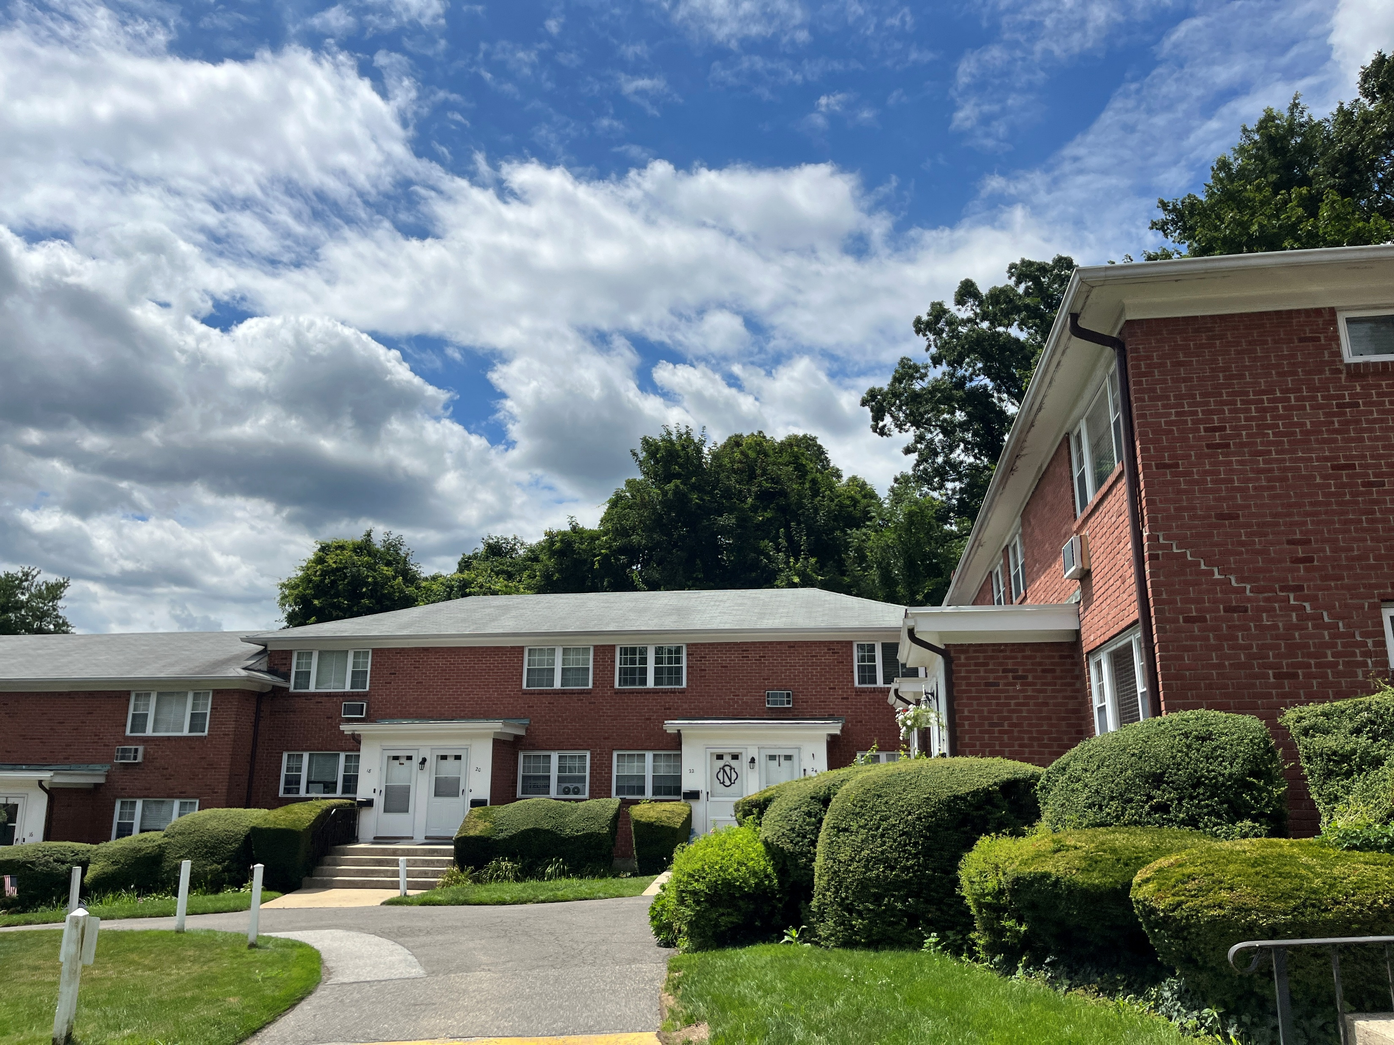
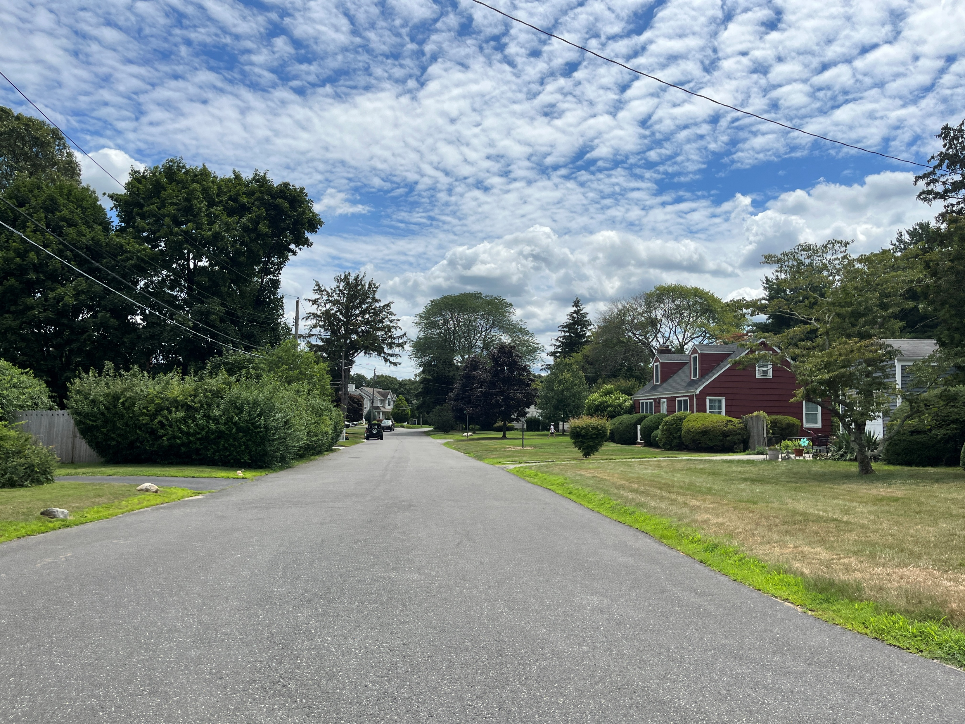
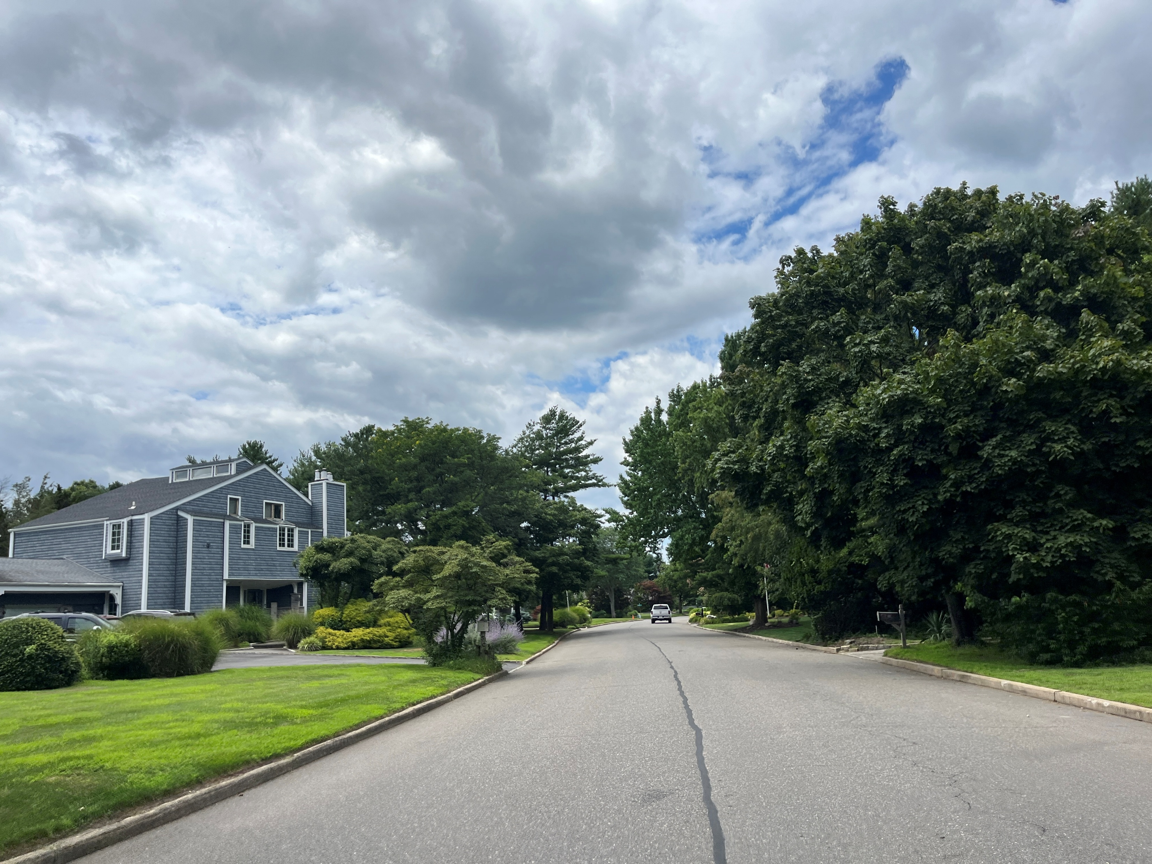
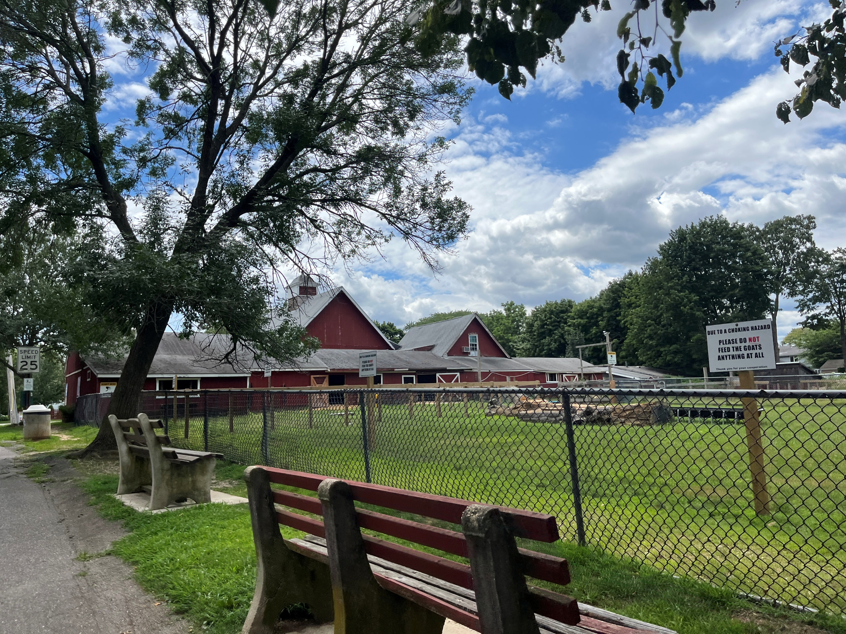
CONCEPTUAL LAND USES
Medium-Density Residential
Low-Density Residential
Agriculture
High-Density Residential

Slide 18
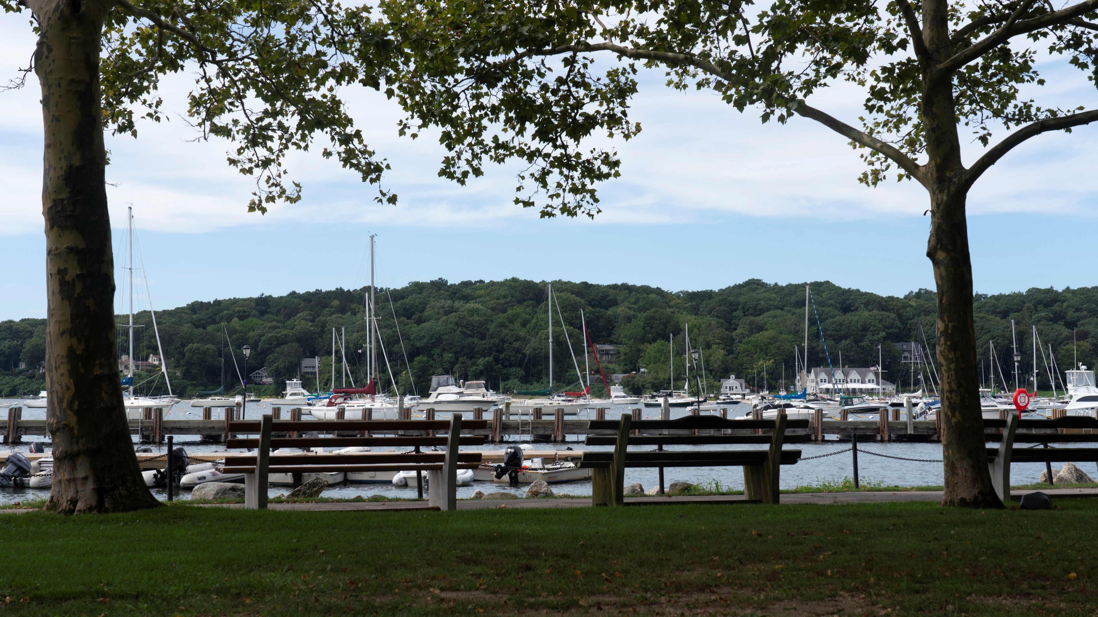
PLAN POLICY FRAMEWORK
GOAL CATEGORIES
Vision Statement
Goal
Objective
Goal
Objective
Goal
Objective
Objective
Objective
Objective
Objective
Housing
Land Use and Zoning
Historic/Aesthetic Resources
Sustainability/ Environmental Resources/Climate Smart
Utilities/Stormwater/Infrastructure
Traffic/Parking/ Transportation
Recreation and Open Space
Economy

Slide 19
GOALS
Housing
Goal 1: Protect existing residential uses and neighborhoods in the Village while exploring opportunities to provide additional housing options, ensuring that future housing development is consistent with the scale, density and size preferred by the Village.
Land Use and Zoning
Goal 2A: Protect the existing land use patterns while allowing for the continued reasonable and small-scale growth of residential and commercial uses which are consistent with the scale and density of existing development, and do not impact the Village’s environmental, scenic and historic resources.
Goal 2B: Review and update the Zoning Code to ensure it accommodates the evolving needs and goals of the Village, while preserving the current community character and scale of development.
Goal 2C: Ensure that any proposed new development or redevelopment within the Village is consistent with the historic community character of Northport and adequately protects the existing natural resources and scenic beauty.
Historic/Aesthetic Resources
Goal 3A: Protect and enhance the historic and scenic resources within the community that have established the Village’s unique sense of place.
Goal 3B: Establish a historic preservation program that celebrates the history of Northport through education and visibility.

Slide 20
GOALS
Sustainability/Environmental Resources/Climate Smart
Goal 4A: Create an integrated sustainability and planning framework for the Village to ensure long-term environmental health and community stability.
Goal 4B: Promote sustainable practices in the Village to reduce waste and pollution.
Goal 4C: Protect and enhance the Village’s natural vegetation and biodiversity.
Goal 4D: Support the protection, restoration, and long-term health of the waterfront.
Utilities/Stormwater/Infrastructure
Goal 5: Ensure that the Village has adequate infrastructure to serve its residents and ensure that the improvements are designed to address changes due to climate change.

Slide 21
GOALS
Traffic/Parking/Transportation
Goal 6A: Align transportation investments with smart growth and context-sensitive planning principles.
Goal 6B: Promote a multimodal transportation system which prioritizes an interconnected pedestrian network while improving traffic mobility.
Goal 6C: Address vehicular traffic flow and parking congestion issues to improve local mobility.
Recreation and Open Space
Goal 7: Maintain and upgrade existing recreational facilities to provide increased amenities, opportunities, and increased accessibility.
Economy
Goal 8: Provide an environment that fosters the long-term economic stability and diversity of the community in keeping with the general character of Northport.

Slide 22
EXAMPLE:
GOALS & OBJECTIVES - LAND USE AND ZONING
Goal 2A: Protect the existing land use patterns while allowing for the continued reasonable and small-scale growth of residential and commercial uses which are consistent with the scale and density of existing development, scenic and historic resources
Objective 2A.1 - Continue to protect existing land use patterns in the Village
Objective 2A.2 - Support land uses in the Downtown which are balanced between residents’ and visitors’ needs
Objective 2B.1 - Identify and implement Zoning Code clarifications.
Objective 2B.2 - Identify and amend inconsistencies in the Zoning Chapter, where appropriate.
Objective 2B.3 - Consider adding “Purposes” or “Intents” to the Zoning Code that are specific to each district.
Goal 2B: Review and update the zoning code to ensure it accommodates the evolving needs and goals of the Village, while preserving the current community character and scale of development
Objective 2B.4 - Continue to promote the existing scale of buildings within the Village, and particularly the Downtown area.
Vision Statement
Objective 2B.5 - Consider introducing a maximum size requirement for commercial establishments.
Objective 2B.6 - Review existing zoning requirements for large parcels and analyze potential rezoning to protect natural resources, open space, and align with the community’s visions.
Objective 2B.7 - Explore the possibility of creating new zoning districts or overlay districts to protect unique land uses, such as the Lewis Oliver Farm Property.
Goal 2C: Ensure that any proposed new development or redevelopment within the Village is consistent with the historic community character of Northport and adequately protects the existing natural resources and scenic beauty.
Objective 2C.1 - Evaluate options to ensure that new development is required to set aside greenspace.
Objective 2B.2 - Consider requiring a traffic study for larger development/redevelopment projects that have the potential to significantly increase traffic conditions.
Objective 2B.3 – Consider options to ensure any large new subdivision proposed explores the possibility of a cluster subdivision to preserve the greatest amount of open space.

Slide 23
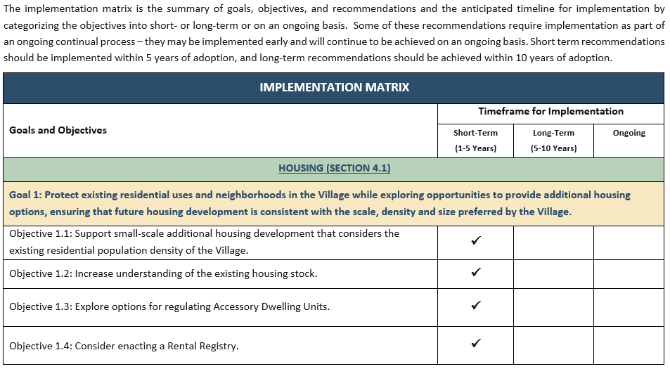
IMPLEMENTATION MATRIX

Slide 24
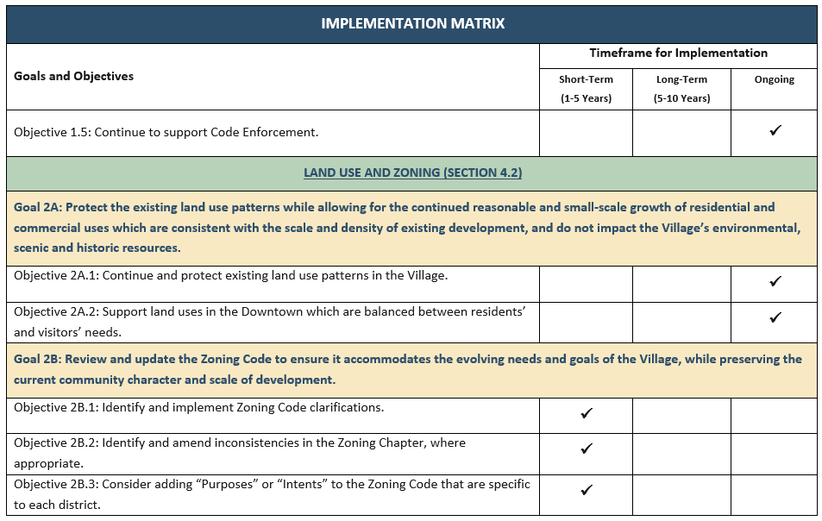
IMPLEMENTATION MATRIX

Slide 25
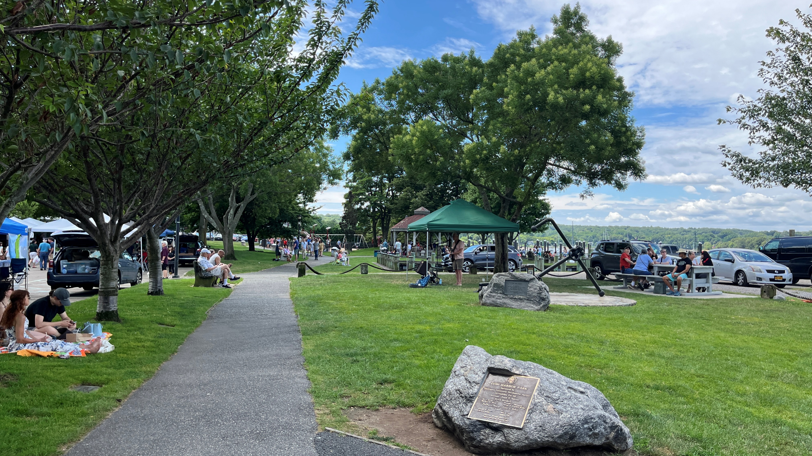
NEXT STEPS
Review of Plan by Village Boards and the Public
Adoption of the Comprehensive Plan
Complete Environmental Review
Finalize Comprehensive Plan

Slide 26
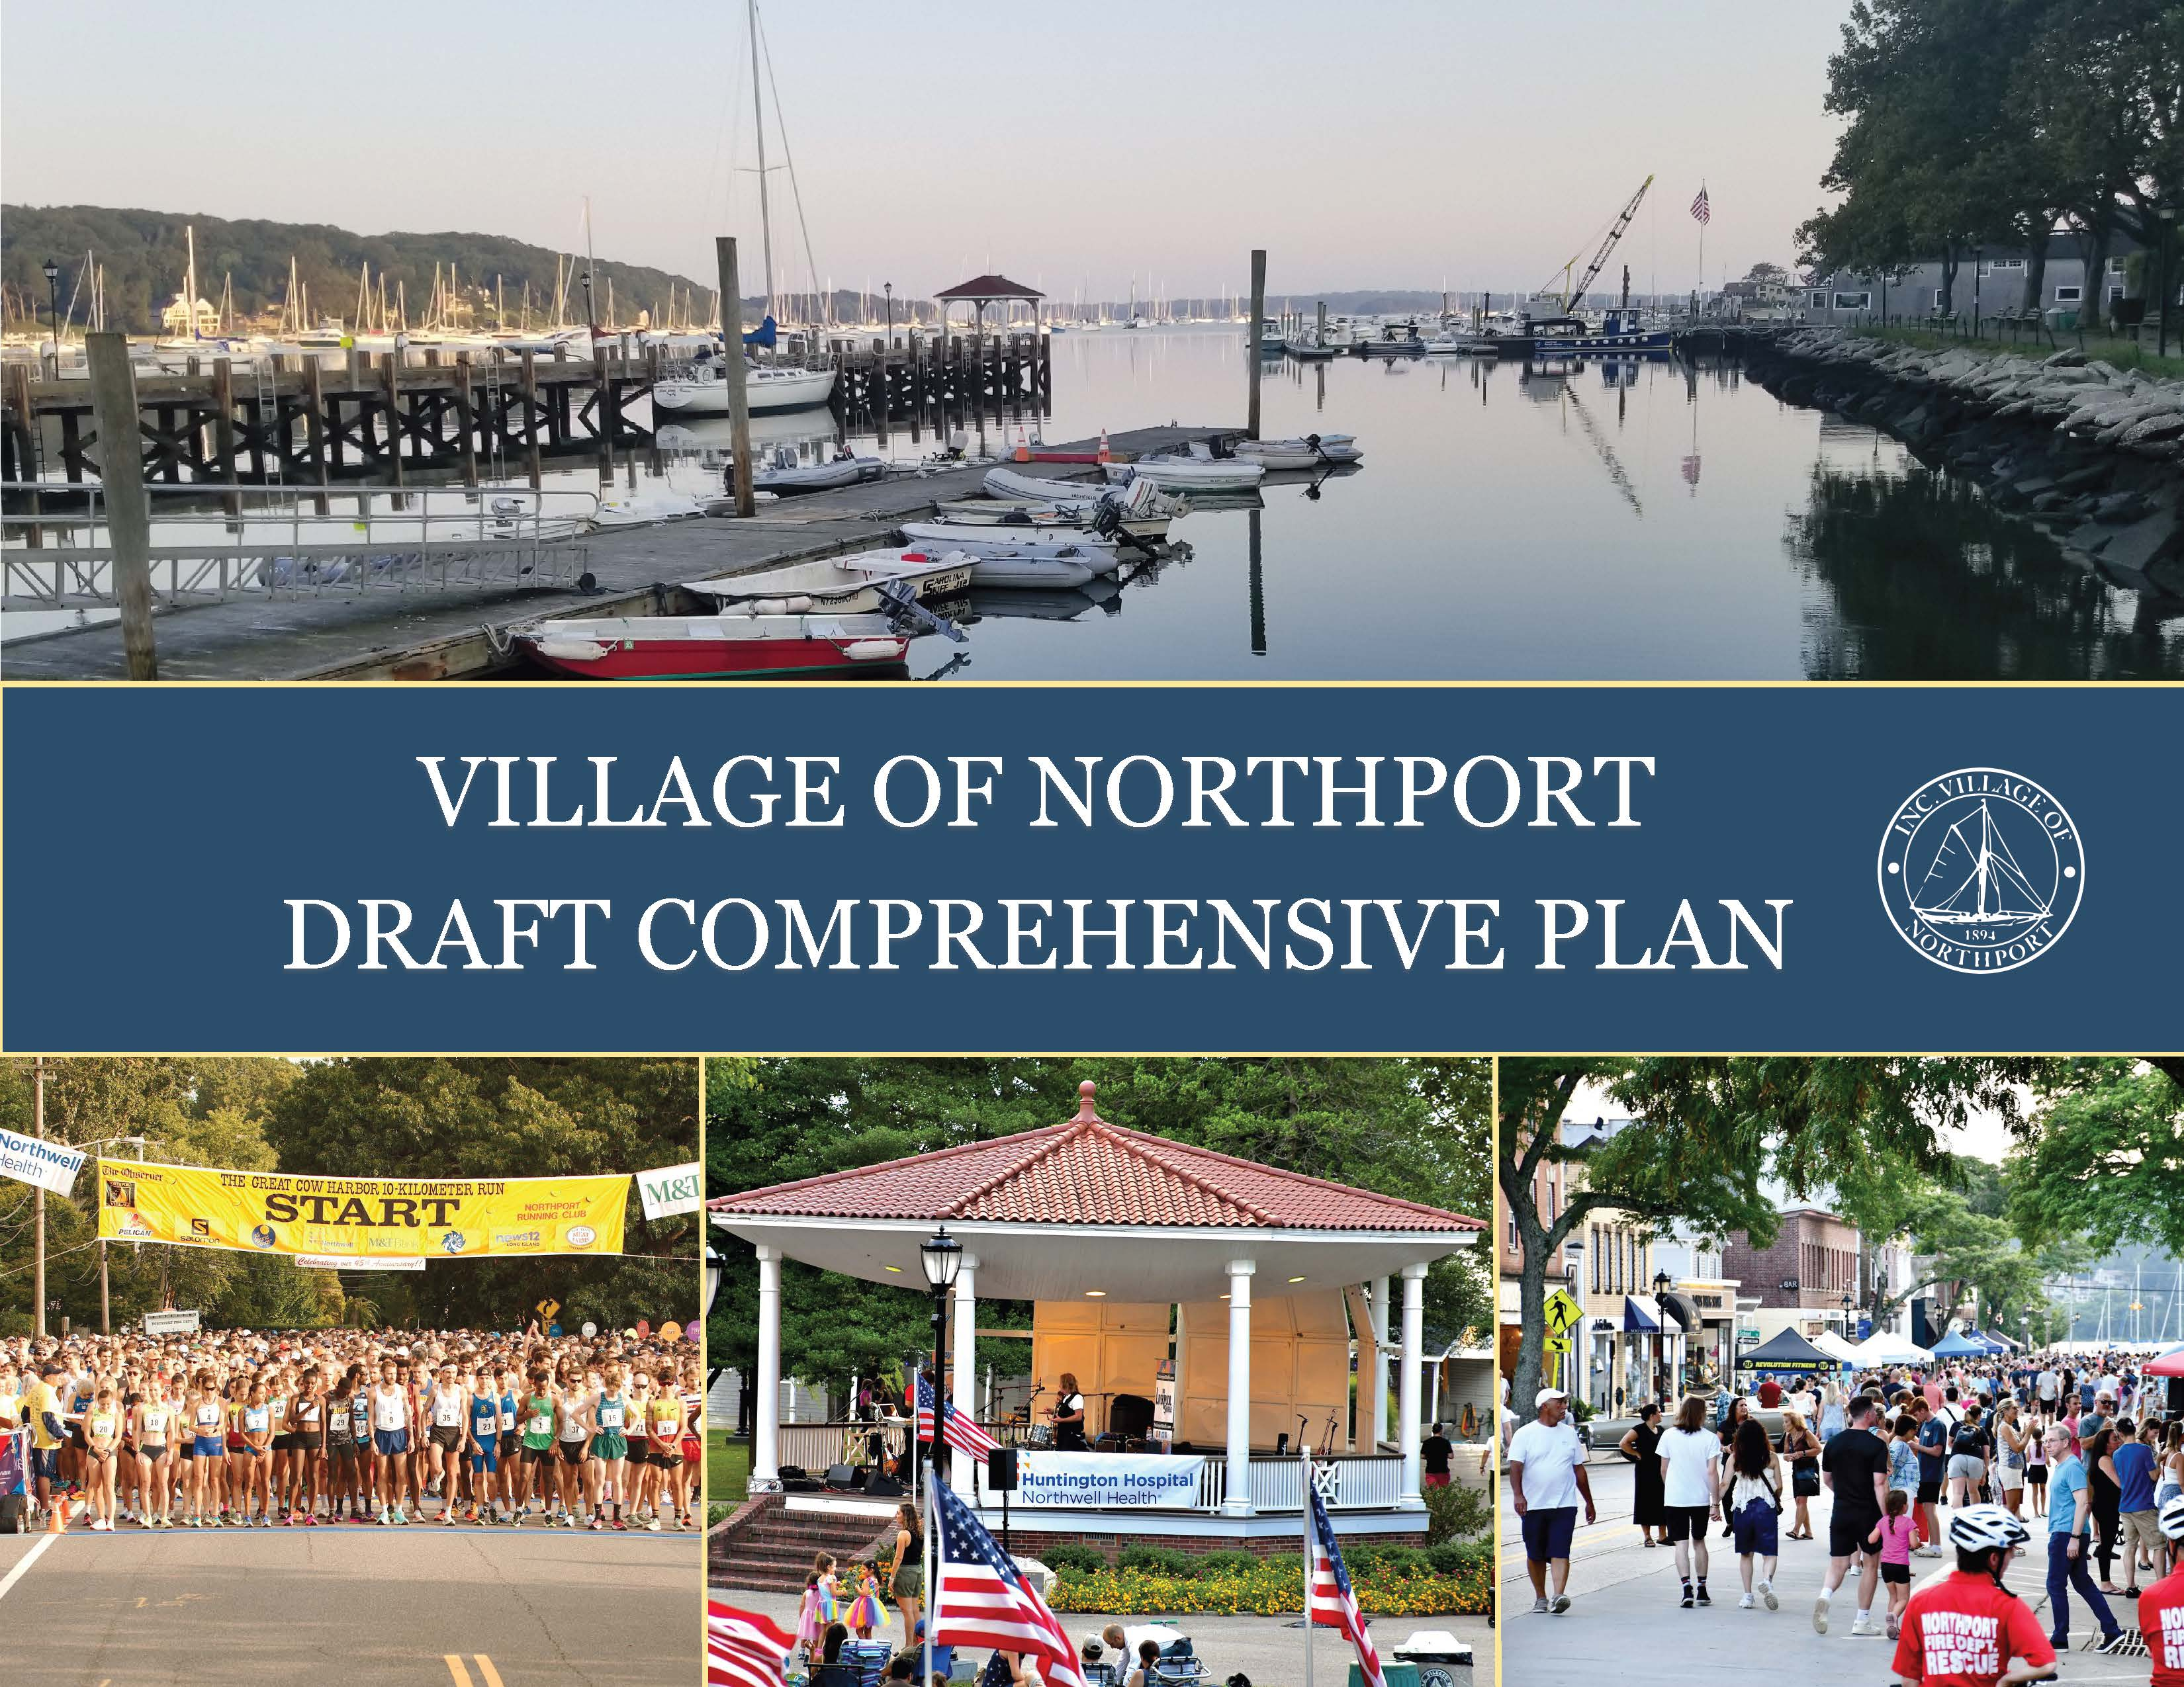
THANK
YOU!
SUBMIT COMMENTS TO
nptcomprehensiveplan @northportny.gov

Slide 27
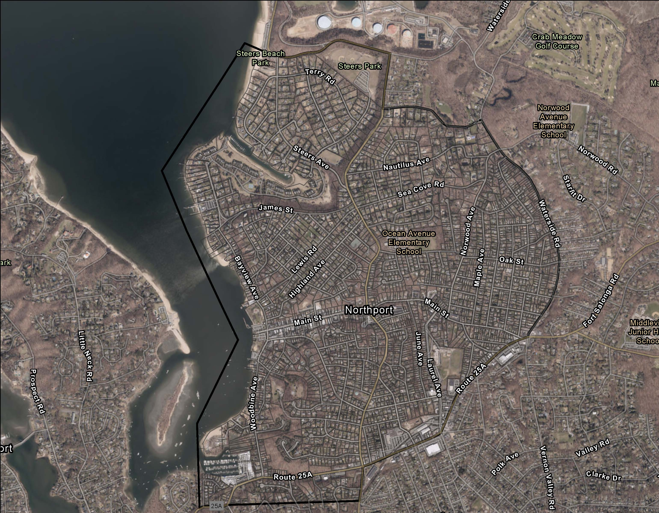
VILLAGE OF NORTHPORT AERIAL MAP

